Slide 1
Three Phase Structure with an
EL Intervention Strategy
Presenters: Ms. Rubio and
Mr. Jimenez

Slide 2
Problem
“It’s fascinating to me that some of the pushback is coming from, sort of, white suburban moms who - all of a sudden - their child isn’t as brilliant as they thought they were and their school isn’t as good as they thought they were, and that’s pretty scary.” – Arne Duncan, Secretary of Ed.
Will EL learners be able to access the CCSS if they are already underperforming compared to all other groups in the LAUSD?

Slide 3
CST Math Results Percent of Students Who are At or Above Proficient 2009 - 2013

Slide 4
Hillside ES CELDT Annual Assessment
Results for 4th and 5th Grade 2012-2013
Performance Level | 4th Grade | 5th Grade | Total
Advanced | No students at this level | 2 | 12
 | 0% | 12% | 10%
Early Advanced | 2 | 7 | 30
 | 10% | 41% | 26%
Intermediate | 14 | 6 | 45
 | 70% | 35% | 38%
Early Intermediate | 4 | 1 | 21
 | 20% | 6% | 18%
Beginning | No students at this level | 1 | 9
 | 0% | 6% | 8%

Slide 5
What is Known From the Research
“ELs not only face the common obstacles all students experience in attempting to gather, manage, and organize the flow of information; they also must analyze and evaluate what they read while negotiating a second language” (Bunch, G. C., Kibler, A., & Pimentel, S. (2012, p.18)
Math Practices the Los Angeles Unified School District is asking our school to focus on require students to be able to listen, speak, read, and write effectively using standard English. Moschkovich (2012) points out that for EL students developing these skills, the CCSS will be especially challenging.

Slide 6
Rationale
LAUSD’s focus for all schools in the area of Math and the CCSS: M.P.1, M.P.3, and M.P.4
  M.P.3: asks them to construct viable arguments and critique the reasoning of others by asking questions to help their classmates clarify their argument
Hillsides’ Focus:
  English Language Learners
  Math
  Three-Phase Structure Model at least once per week

Slide 7
Three – Phase Structure
Phase I: 5 – 10 minutes
  Make sure students understand the problem
Phase II: 20 – 25 minutes
  Students work independently to solve the problem (about 5 – 10 min.)
  Students work collaboratively (15 – 20 min.)
Phase III: 10 – 15 minutes
  Groups present to the learning community so we can all critique and learn from their examples
Phase IV (optional): 5 minutes
  Students get an opportunity to revise and add to their templates

Slide 8
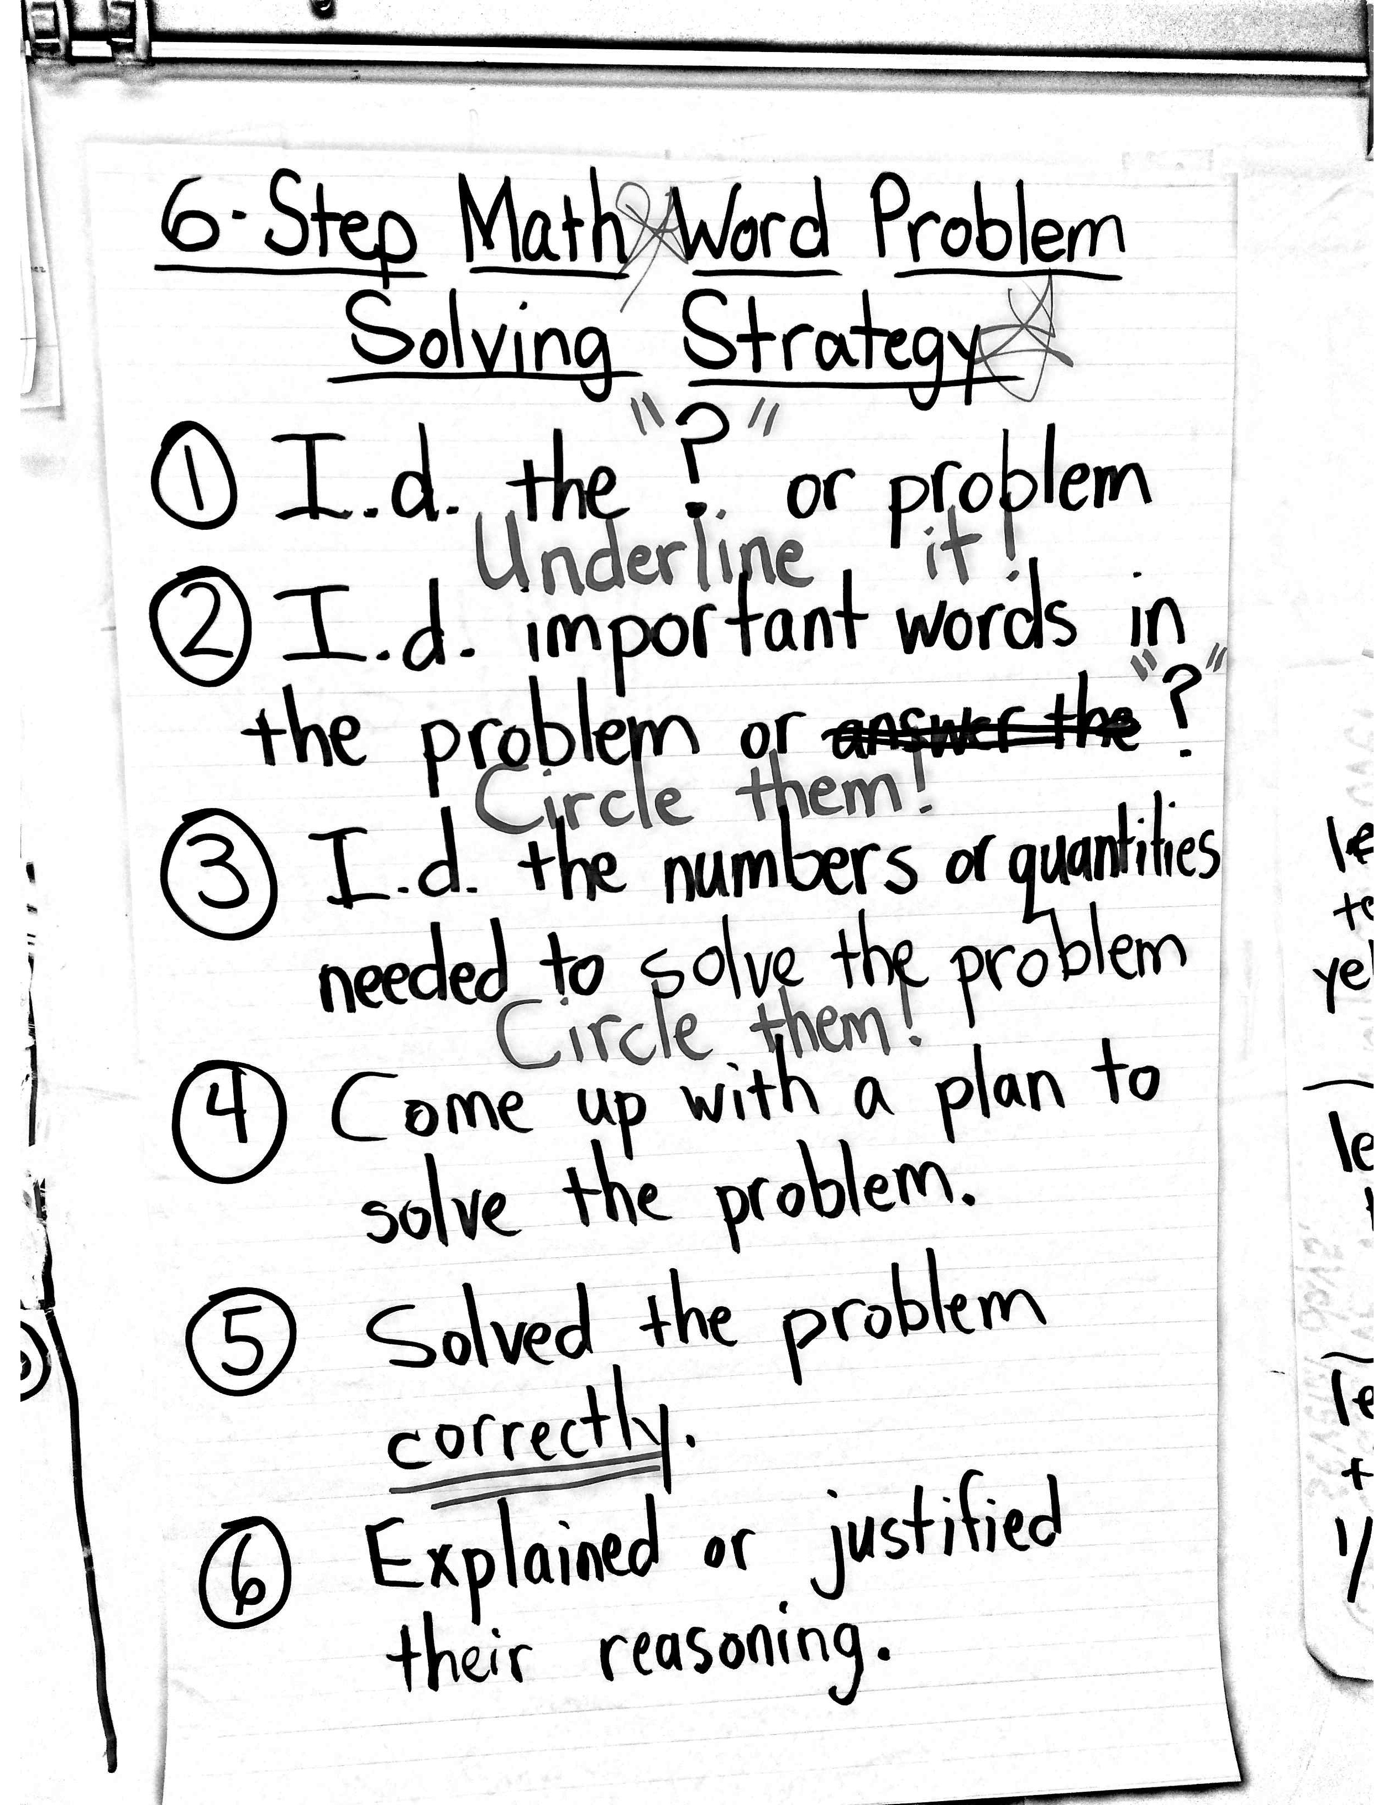
El Intervention Strategy
Six Step Math Word Problem Solving Strategy

Slide 9
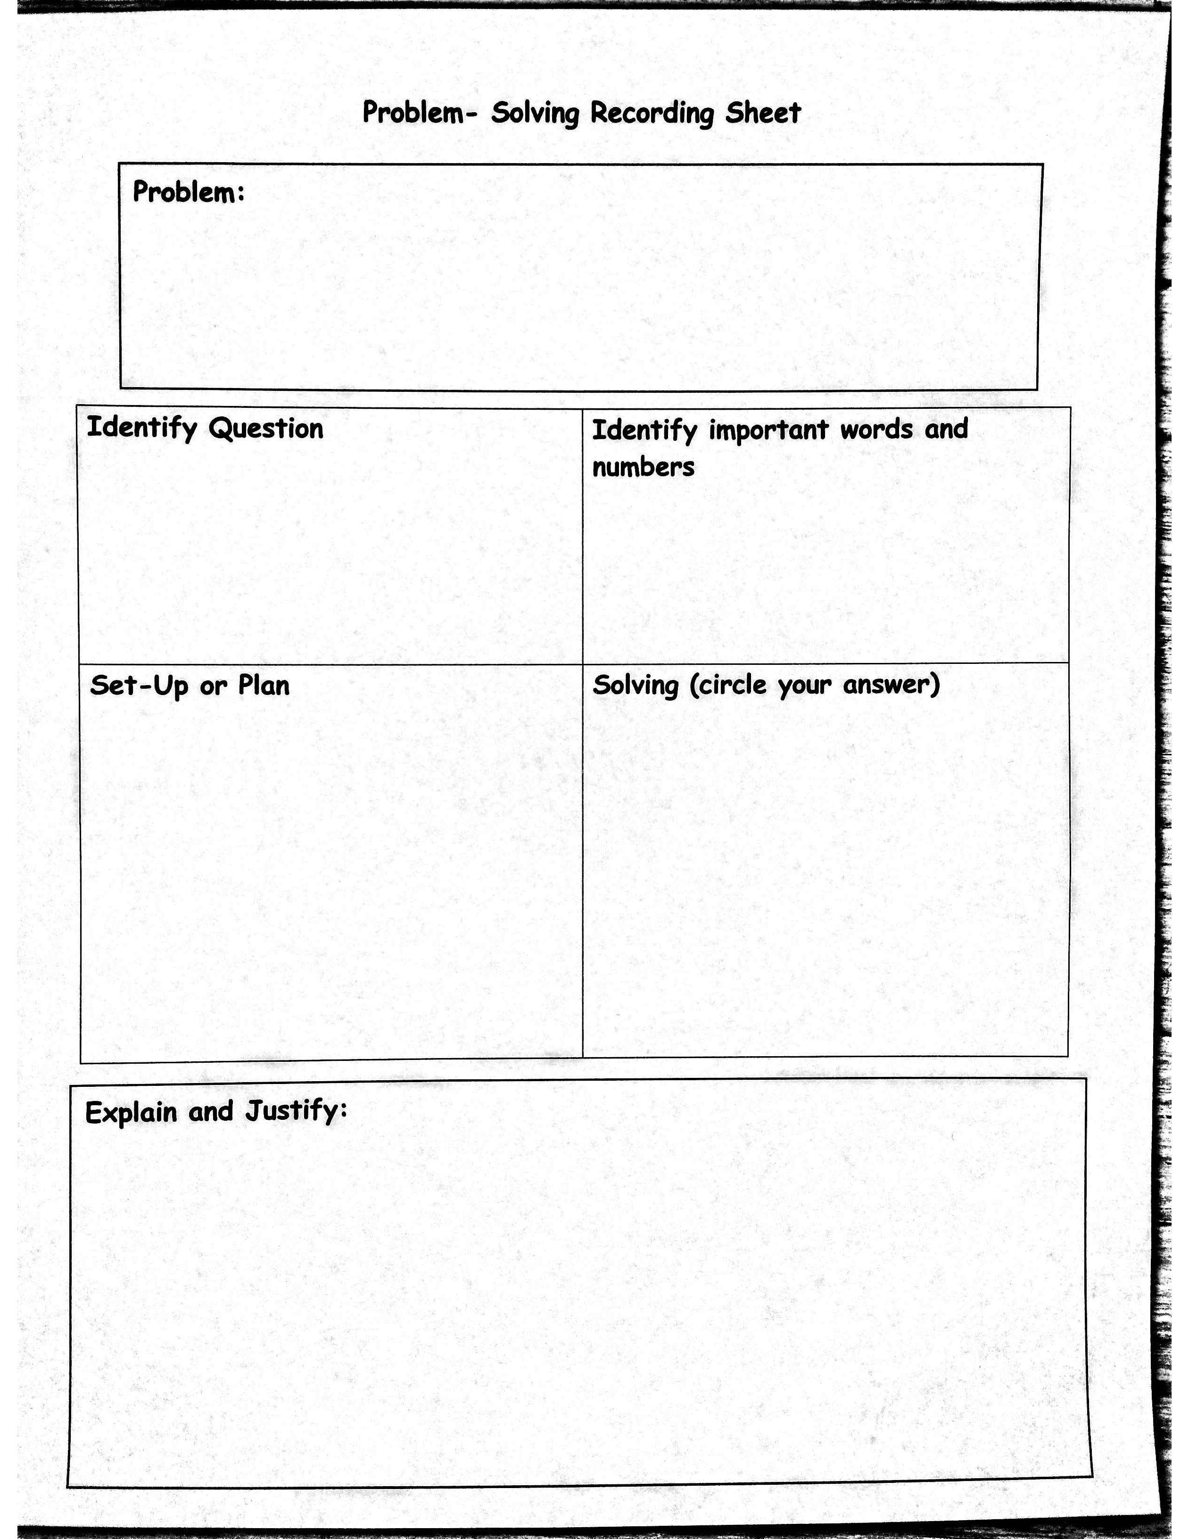
Template
Actionable feedback can be provided on the template itself.

Slide 10
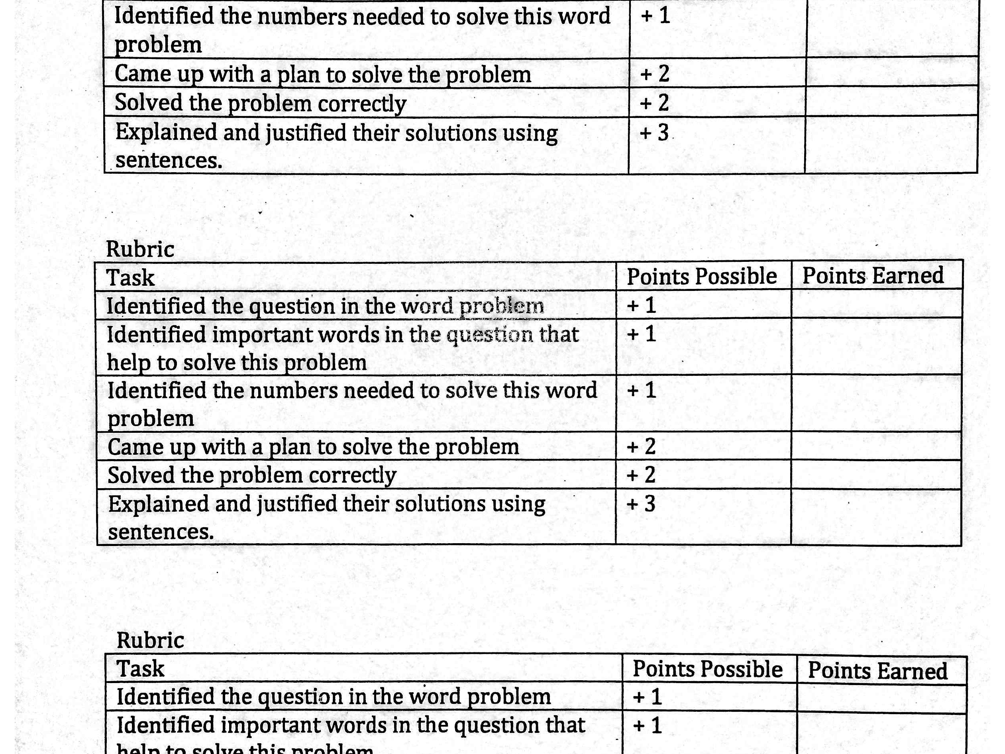
Rubric
Actionable feedback can be provided here or on the template students fill in.

Slide 11
Learning Cycles
1st PDSA Cycle – 5th grade students in after school intervention class
  Assessed 5th grade intervention class for baseline data
  Conducted intervention for 3 sessions and assessed students to monitor progress and effectiveness of intervention
  There were two major goals:
    To improve lesson delivery, template, and rubric
    To increase student proficiency at solving math word problems

Slide 12
Data from Afterschool Intervention
19 out of 21 students received a Satisfactory score on their report cards (which means they showed some improvement)
On the pre-assessment 1 student scored 50% or better
On the post-assessment 6 students scored 50% or better

Slide 13
Learning Cycles
2nd PDSA Cycle – All 5th grade students
  Assessed students using the District’s 1st PA to establish baseline data (01/14/14)
  Implemented intervention (4 sessions)
  Assessed to measure student progress and implement changes if necessary

Slide 14
Data for 2nd PDSA Cycle
Rubios’ Class
  On the pre-assessment 1 out of 28 students scored 50% or better
  On the post-assessment 16 out of 28 students showed some improvement
  10 out of 28 students scored 50% or better

Slide 15
Data for 2nd PDSA Cycle
Jimenez’s Class
  On the pre-assessment 4 out of 30 students scored 50% or better
    1 EL learner (out of 16)
  On the post-assessment 24 out of 30 students showed some improvement
  18 out of 30 students scored 50% or better
    6 EL learners (out of 16)

Slide 16
Learning Cycles
3rd PDSA Cycle – 4th and SDC classrooms
  Present intervention along with data and findings (Feb. 4th, 2014)
  Model lessons in classrooms (Week of Feb. 10th)
  Begin intervention across multiple grade levels in multiple classrooms (Week of Feb. 17th)

Slide 17
Next Steps
Meet with my team to discuss data, results of PA I and PA II, and compare EL progress to that of EOs and RFEPs
Implement three phase, 6-step math word problem solving strategy school wide in 2013-2014 school year

