Slide 1
Assessment
You all did a GREAT job unpacking the ELA Reading CCS. THANK YOU for your effort!
What is assessment?
What types of assessment are there?
What types of assessment do we implement at St. John Eudes?
Why do we implement various assessments? What is the purpose behind assessments?
What is authentic assessment?
N. Scheppers UCLA PLI Cohort 14
ELA Reading CCS PD, November 22, 2013

Slide 2
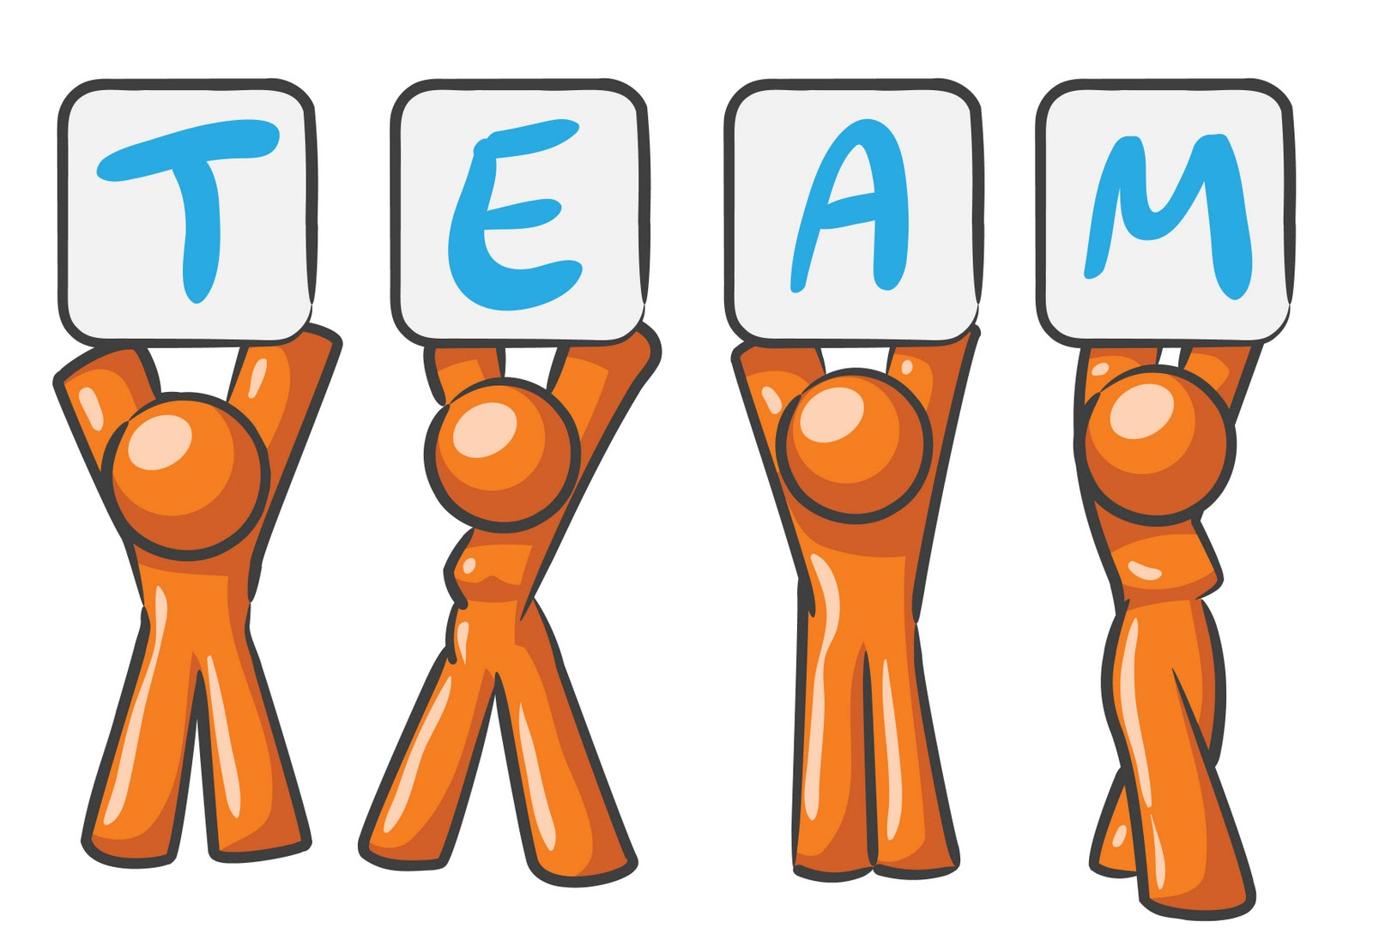
ELA Reading CCS: Where are we now?
Unpacking ELA Reading CCS – GOOD JOB!!! ☺
Where are we in the process?
September: Rationale and Transition to CCS
September: Organization/Vertical Analysis
September-November: Unpacking the ELA Reading CCS K-8
November – February: Creating grade level reading benchmarks
March: Finish grade level reading benchmarks
March-April: Create grade level reading benchmark rubrics
May: Create St. John Eudes Artifact Rubric

Slide 3
TODAY:
Review and distribute unpacking standards K-8
Discuss assessment…
Analyze 4th Grade CCS ELA Reading Informational Text Assessment
Whole group work – finish 4th grade Informational Reading Assessment
Break into grade level groups (per Wednesday’s email) to begin grade level literature, informational and foundational skill assessments
Due February 21
First Check-in Dec. 16

Slide 4
What is assessment?
What do you think of when
you hear “assessment”?
Assessment is…
The evaluation or estimation of the nature, quality, or ability of someone or something.
Gathering information and data in any way that you can from a wide variety of sources
Any method through which one gathers data to find out about something

Slide 5
What are some types of assessment?
Pre-assessment:
Administer before you begin a unit of work
Helps you understand what your students know, understand and are able to do before the unit begins
Shows you which students are ready to learn the new information, which students already know what you are going to teach, and which students are not yet prepared for the new learning
Allows students to demonstrate mastery or show where they need remediation before instruction
Helps you determine a timeline for instruction
Shows you when you need to use tiered lessons
and/or flexible groups
Examples:
Student observation/Class Discussion, Concept Maps

Slide 6
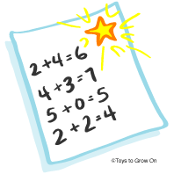
What are some types of assessment?
Formative Assessment:
Identifies which students have reached their learning goals and which need more time, more help and/or more practice
Allows you to guide instruction in response to the learning differences you see after students begin doing their work
Alerts you about the misconceptions some students may have about what is being taught
Allows students to change and improve their work before turning it in for a final grade
Gives students descriptive feedback so they can see what they have achieved, which answers are correct and how they might improve
Examples:
Quizzes, work samples
“Thumbs” up, down, middle
Peer evaluation

Slide 7
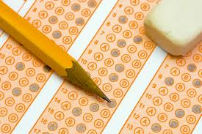
What are some types of assessment?
Summative Assessment:
Should parallel the formative assessments that were used during the learning process
May determine an exit grade or score and can be tied to a final decision about a student
Should align with instructional/curricular objectives, standards and benchmarks
May be a form of alternative assessment; doesn’t always have to be a test
Examples:
Final test
ITBS
Final project

Slide 8
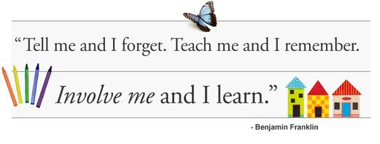
What is “Authentic” assessment?
A form of assessment in which students are asked to perform real-world tasks that demonstrate meaningful application of essential knowledge and skills -- Jon Mueller
"...Engaging and worthy problems or questions of importance, in which students must use knowledge to fashion performances effectively and creatively. The tasks are either replicas of or analogous to the kinds of problems faced by adult citizens and consumers or professionals in the field." - Grant Wiggins
"Performance assessments call upon the examinee to demonstrate specific skills and competencies, that is, to apply the skills and knowledge they have mastered." - Richard J. Stiggins
What does it look like?
An authentic assessment usually includes a task for students to perform and a rubric by which their performance on the task will be evaluated.

Slide 9
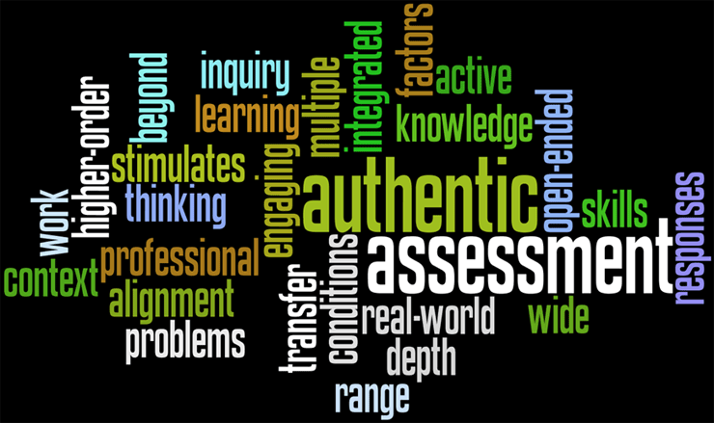
Why do “authentic” assessment?
AIM: To assess many different kinds of literacy abilities in contexts that closely resemble actual situations in which those abilities are used
Authentic assessments are Direct Measures
We do not just want students to know the content of the disciplines when they graduate. We, of course, want them to be able to use the acquired knowledge and skills in the real world. So, our assessments have to also tell us if students can apply what they have learned in authentic situations.
Authentic Assessments Capture Constructive Nature of Learning
We cannot simply be fed knowledge. We need to construct our own meaning of the world, using information we have gathered and were taught and our own experiences with the world
Authentic Assessments Integrate Teaching, Learning and Assessment
When presented with a real-world problem to solve, students are learning in the process of developing a solution, teachers are facilitating the process, and the students' solutions to the problem becomes an assessment of how well the students can meaningfully apply the concepts
Authentic Assessments Provide Multiple Paths to Demonstration
We all have different strengths and weaknesses
in how we learn. Similarly, we are different in
how we can best demonstrate what we have
learned.

Slide 10
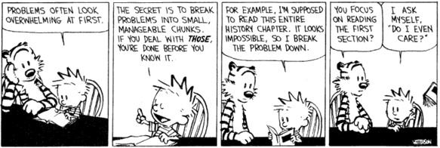
Creating grade level CCS ELA reading assessments, k-8
Sample CCS ELA Reading Assessment, Grade 4
Essential Questions:
WHO is administering the assessment? WHO is taking the assessment?
WHAT is being assessed (purpose/aim)? WHAT is missing from the assessment?
WHERE is the assessment taking place?
WHEN is the assessment taking place?
WHY is the assessment begin given?
HOW is the assessment aligned to CCS ELA Reading?
* Use the sample as a template to guide the creation of your own grade level CCS ELA Reading assessments *
*

Slide 11
Grade Level Objectives
K-3: Sylvia, Debbie, Janet, Alvin and Leslie – Meet in 1st grade
K-3: Create CCS ELA Reading Assessments for Grade 1by Feb. 21
Reading Literature
Reading Informational Text
Reading Foundational Skills
4-5: Haylee, Chris, Angie, Lizette and Sheryl – Meet in 4th grade
4-5: Create CCS ELA Reading Assessments for Grade 4 by Feb. 21
Reading Literature
Reading Informational Text
Reading Foundational Skills
6-8: Niki, Sneha, Cathy, Evelyn, Jayna, Carolina – Meet in 7th grade
6-8: Create CCS ELA Reading Assessments for Grade 7 by Feb. 21
Reading Literature
Reading Informational Text
* First check-in date December 16^{th *}

