Slide 1
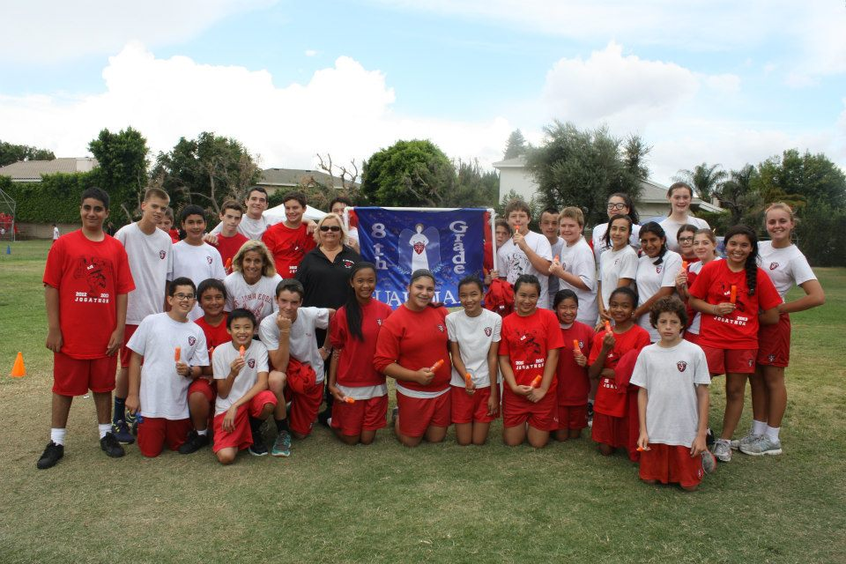
St. John Eudes
Middle School, Grades 6-8
Providing a Christ-centered quality Catholic education for our students since 1966
VALUES-CENTERED EDUCATION
TECHNOLOGY INTEGRATED CURRICULUM
ENRICHMENT PROGRAMS
NATIONALLY RECOGNIZED
STUDENT ACHIEVEMENT & AWARDS

Slide 2
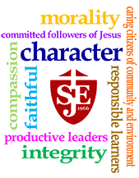
Mission Statement
It is the mission of St. John Eudes School to educate students with Christian morality, character, compassion and integrity, to live as committed followers of Jesus Christ as faithful members of the Catholic Church and to succeed in the 21st century
as responsible learners,
productive leaders,
and caring citizens of their
communities and environment.

Slide 3
Schoolwide Learning Expectations
St. John Eudes students have the opportunity to become:
Active Christians in their Catholic faith
Explain Church teaching, Scripture, and Tradition, and Sacraments
Participate meaningfully in worship, prayer, and the Sacraments
Follow the teachings of Christ and the Ten Commandments
Express God’s love through Christian service (social service and social action)
Apply the Six Pillars of Character to their daily lives (Trustworthiness, Respect, Responsibility, Fairness, Caring, and Citizenship)
Educate themselves and others about justice, equity, and peace
Practice inclusiveness
Celebrate cultural diversity
Engage in respectful dialogue with people who have different perspectives
Respect God’s creation
College & Career Ready in the 21st Century
Become self-directed learners who formulate meaningful questions and effectively seek out and use human, print, and digital resources to address those questions
Collaborate with others in a respectful and productive way to complete tasks
Construct viable arguments by using logical reasoning and citing precise, relevant evidence
Process, analyze, interpret, and evaluate quantitative and qualitative information while maintaining an open mind
Demonstrate the ability to use multiple strategies to solve problems
Read, see, and listen carefully to improve general knowledge and discipline-specific expertise
Demonstrate command of written and spoken standard English and acquire and use a wide-ranging daily and academic vocabulary
Comprehend and critique complex literary and informational texts across a wide range of types and disciplines
Use productivity tools to collaborate with others, enhance learning, and generate creative works
Practice ethical and responsible use of technology

Slide 4
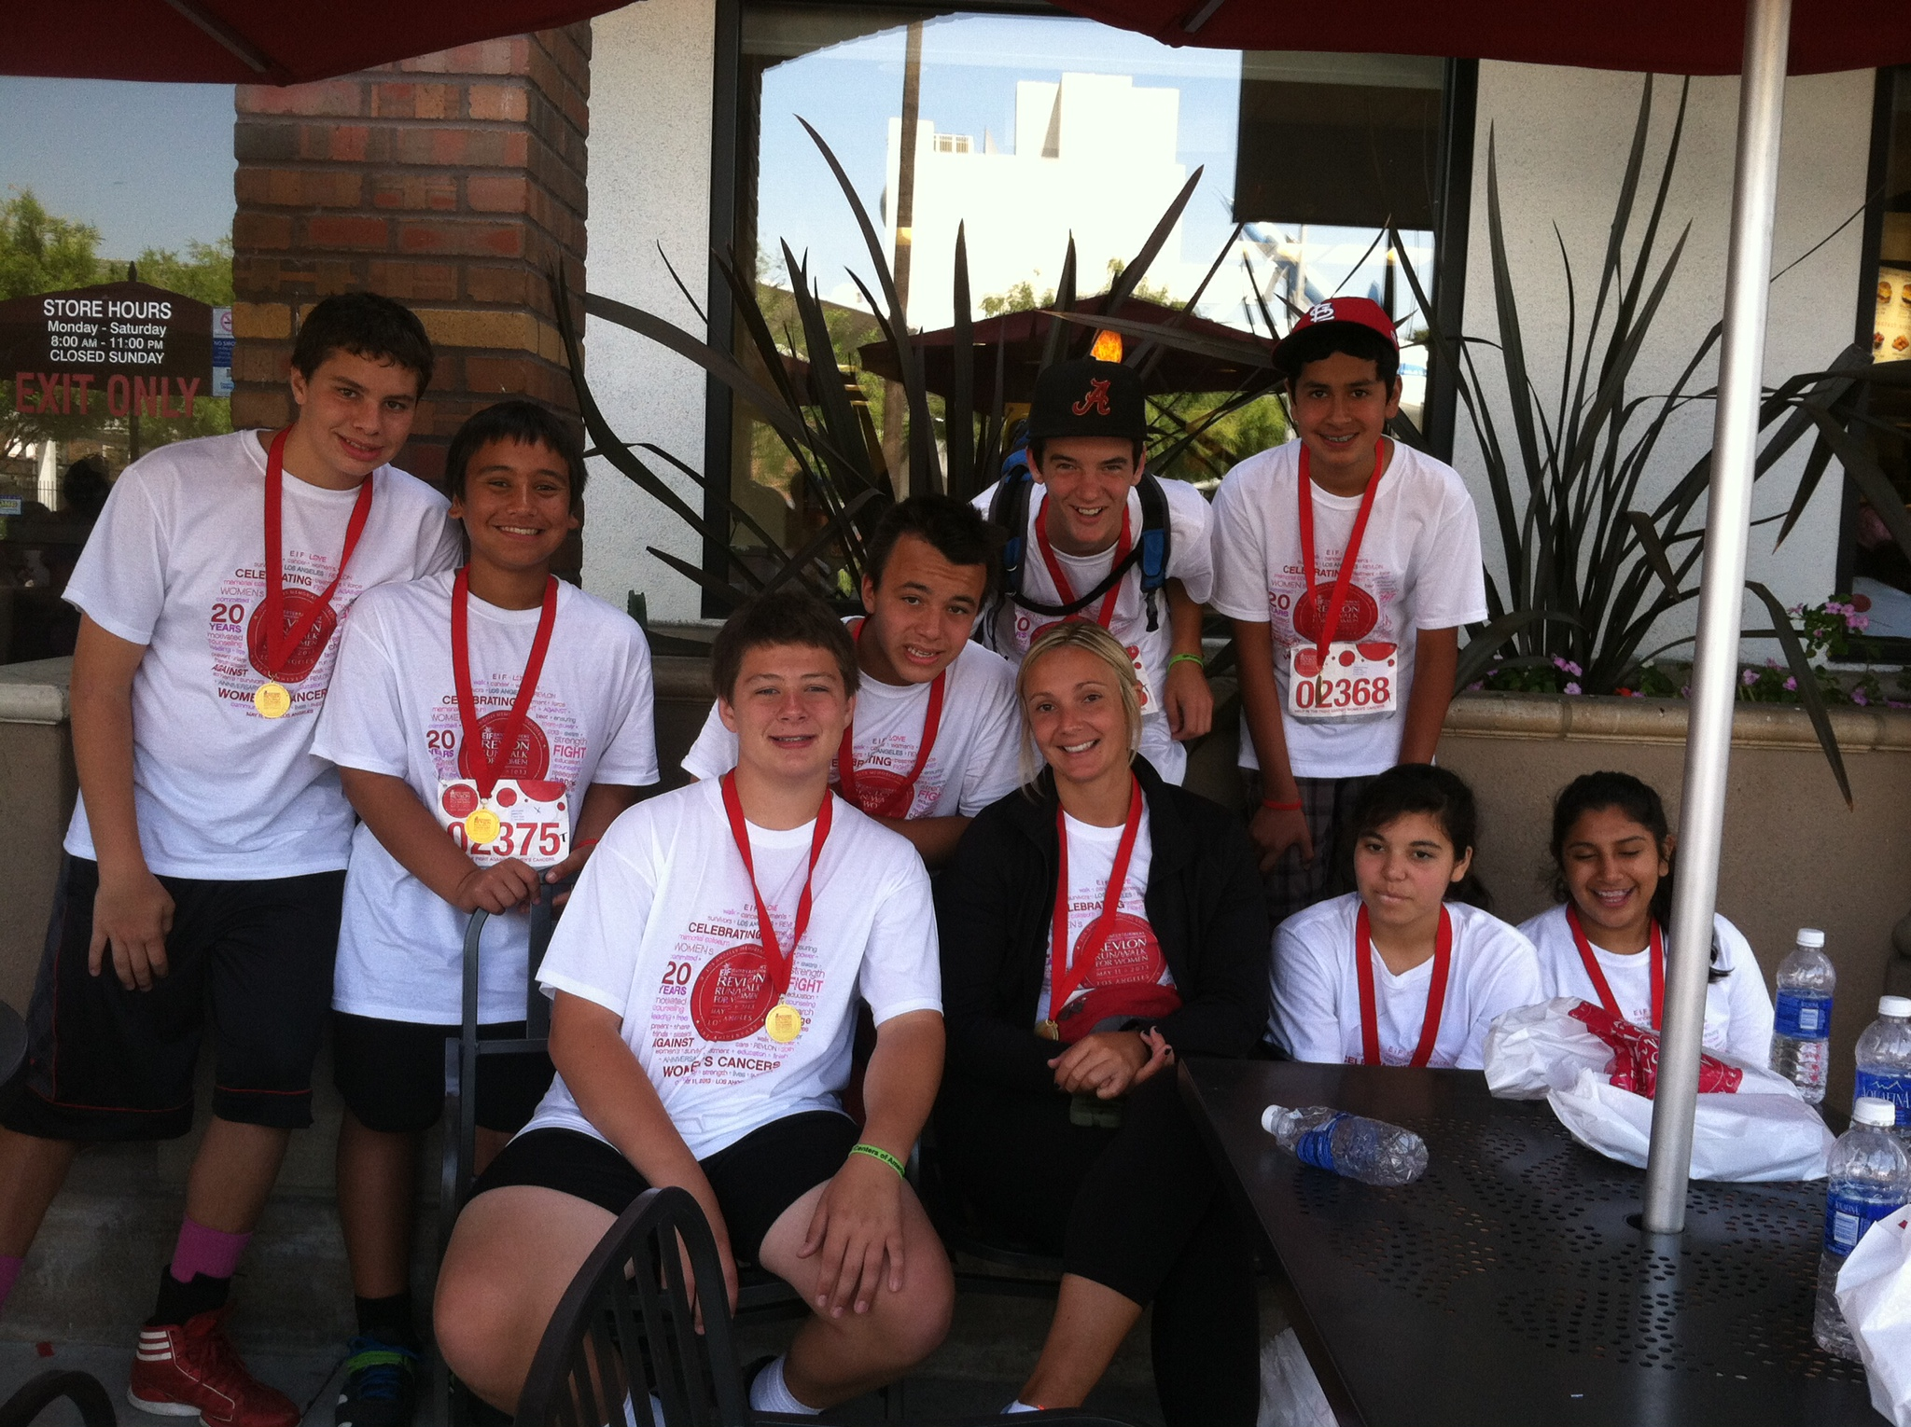
Values-Centered Education
Religious community founded by the Sisters of the Pious Schools teaching and guiding children in the spirit of St. Paula Montal “to save families, teaching children the love of God.”
Fostering the dignity of each student through School wide Learning Expectations
Character education with an emphasis on a yearly theme
Daily prayer, monthly liturgies prepared by each class, grade level retreats
Community Service projects
Glow Buddies between upper
and lower grades

Slide 5
21st Century Learning
1:1 Technology Program preparing students to become college and career ready
Classrooms with Integrated Technology & Computer Systems
Core curriculum corresponding to Common Core Standards and frameworks in English, reading, science, social studies, art, math, religion and physical education
Students benefit from an integrated technology curriculum, individualized attention and high expectations from their teachers
#1 Reason parents send their children to SJE is academics.
Look what follows closely behind!

Slide 6
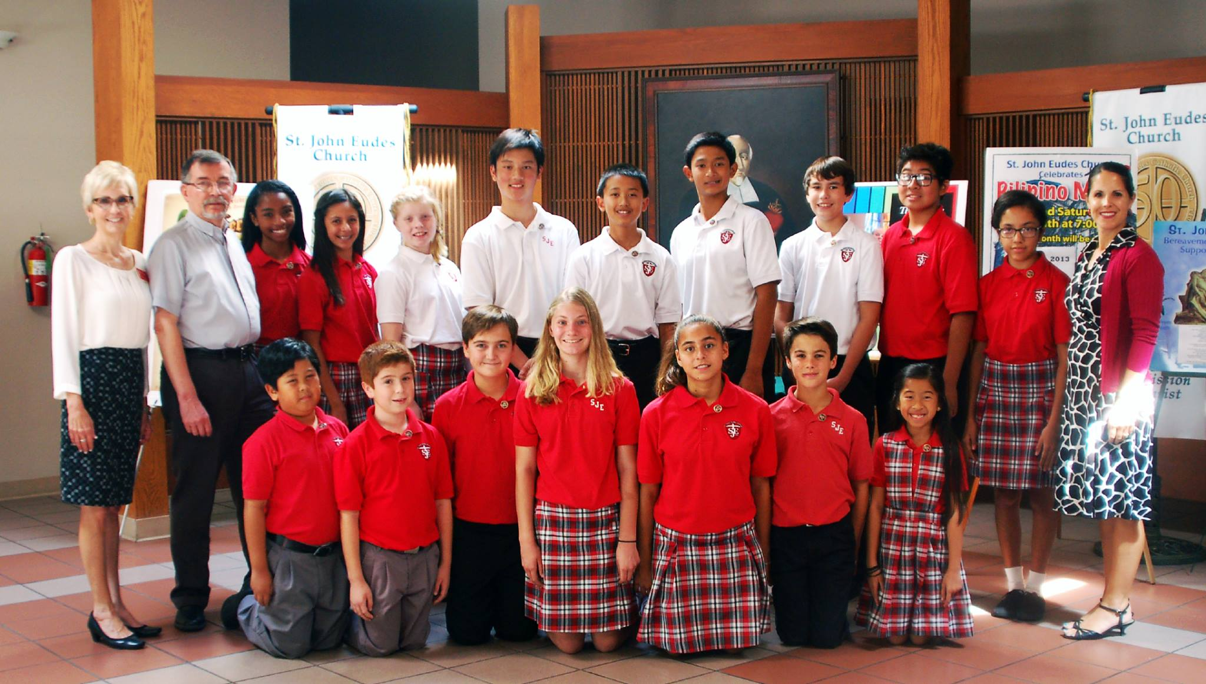
Enrichment Programs
Each student is valued for their own unique gifts and not just their academic standing
The Eagles Interscholastic Sports Teams for Football, Basketball, Volleyball, Softball, Swimming and Track & Field
Student Council
National Junior Honor Society
On-campus Library &
Academic Book Fairs
Music Program, Heaven’s
Grace Children’s Choir
Math Lab & Study Hall
Foreign language class
Eagle Eye Newspaper

Slide 7
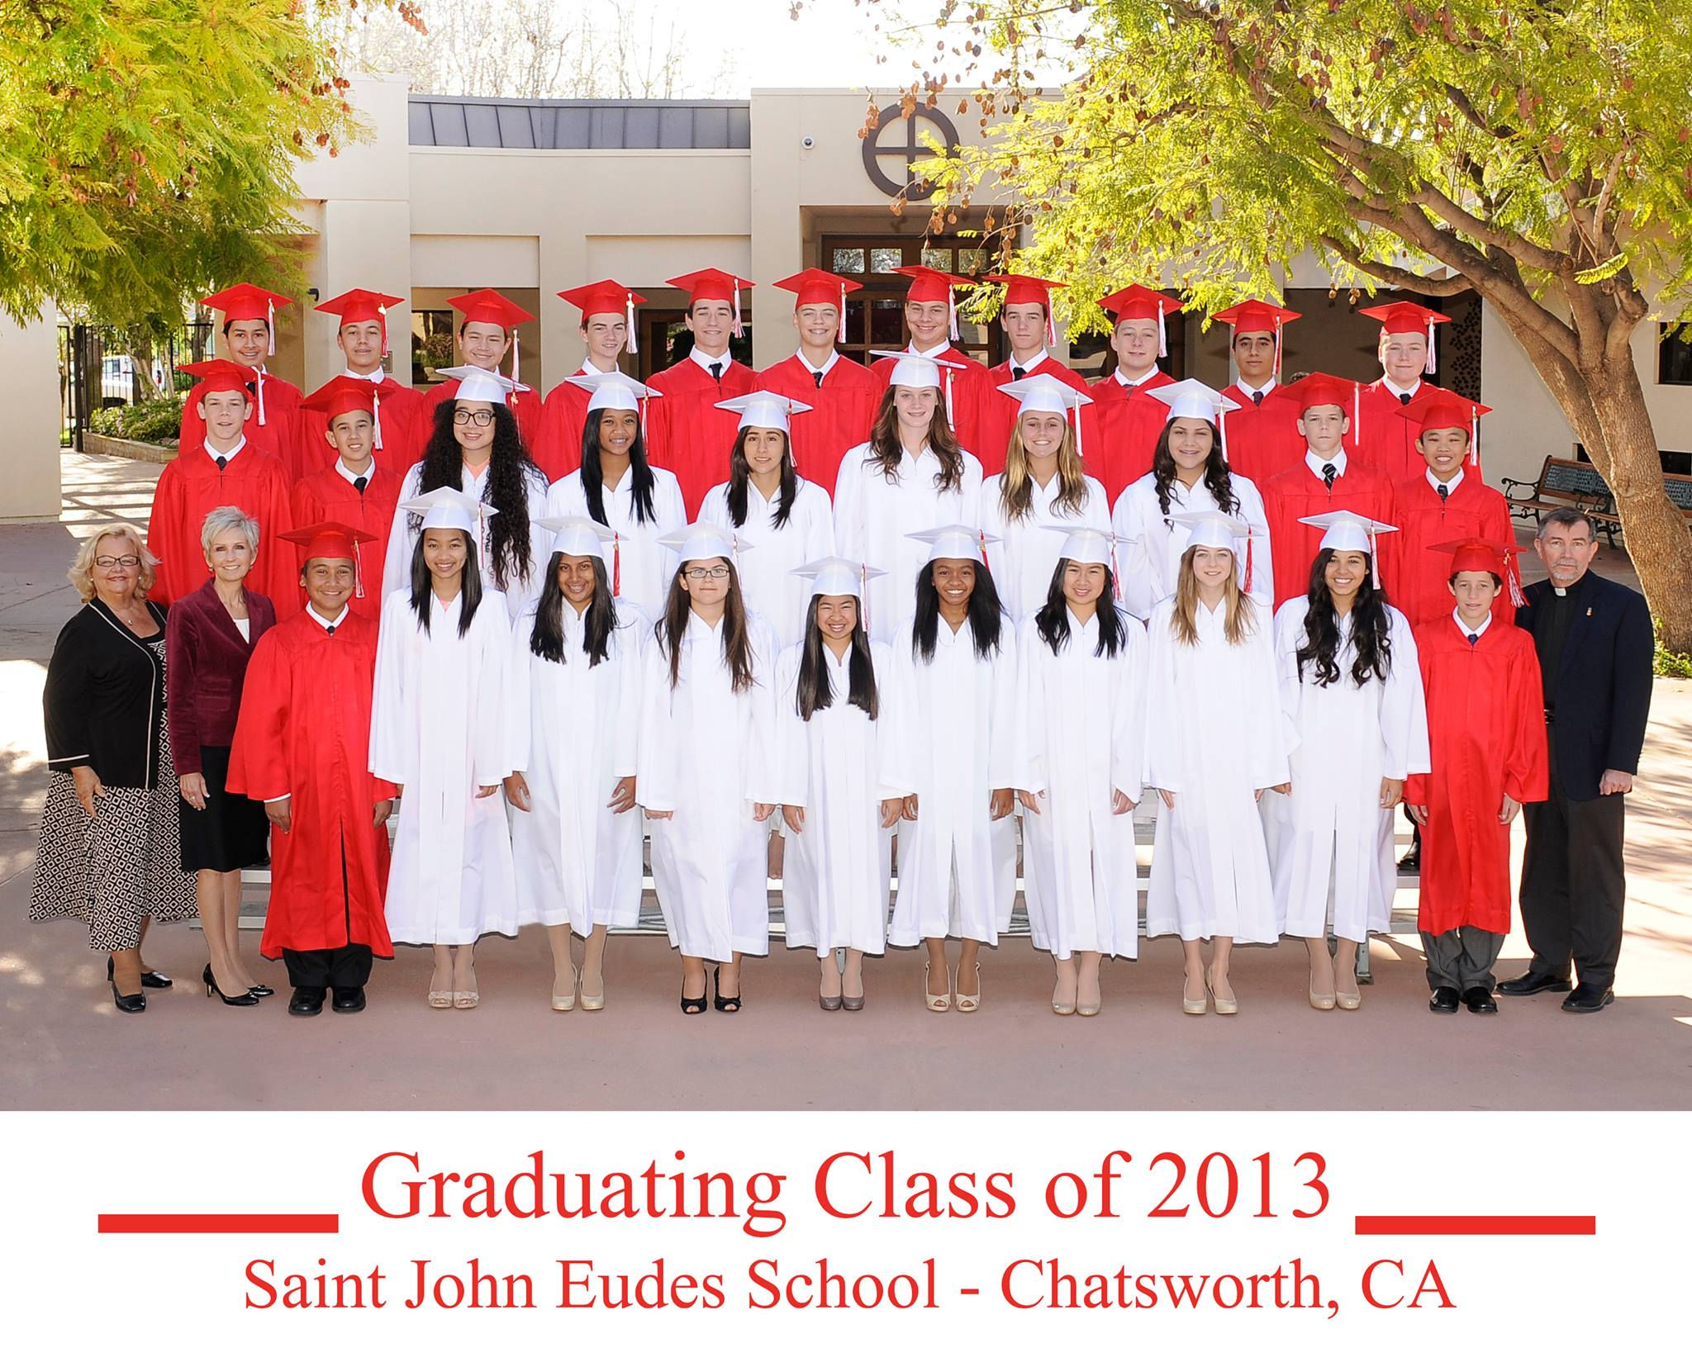
Student Achievement
ITBS Statistics for Grade 8, 2011
Reading – 70th percentile
Language – 76th percentile
Mathematics – 69th percentile
Social Studies – 66th percentile
Science – 75th percentile
Critical Thinking Averages for Grade 8, 2011
Reading – 52% HIGH
Language – 56% HIGH
Mathematics – 59% HIGH
ACRE Test Results for Grade 8, January 2012
Profession of Faith 100%
The Celebration of the Christian Mystery 93%
Life in Christ 96%
Christian Prayer 96%
Graduating Class of 2011-2012
(27 Students)
High Schools Attended by 2012 Graduates :
Bishop Alemany – 4
Chaminade College Preparatory – 5
Crespi Carmelite – 4
Louisville – 2
Notre Dame – 8
St. Genevieve – 2
High Tech. Los Angeles – 1
Saugus High School - 1
63% of 2012 Graduates Received Scholarships & Awards
4 Students Entering High School with Honors (social studies, literature, composition and biology)
2 President’s Awards for Educational Excellence Received

