Slide 1
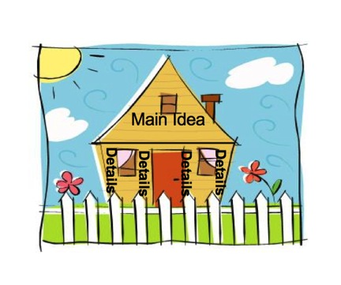
Identifying the Main Idea
By: Lisa Baggio
William Green Elementary
Parent Workshop 2-February 18, 2015

Slide 2
Overview of the Common Core Standards
Purpose: Create a shared consistency in learning goals among different states.
will promote the literacy skills and concepts required for college and career readiness in multiple disciplines.
The standards from grade to grade are steps that build on one another to reach the top

Slide 3
Grade 3 CCSS-Main Idea
CCSS.ELA-LITERACY.RI.3.2
Determine the main idea of a text; recount the key details and explain how they support the main idea.

Slide 4
Grade 4 CCSS-Main Idea
CCSS.ELA-LITERACY.RI.4.2
Determine the main idea of a text and explain how it is supported by key details; summarize the text.

Slide 5
Grade 5 CCSS-Main Idea
CCSS.ELA-LITERACY.RI.5.2
Determine two or more main ideas of a text and explain how they are supported by key details; summarize the text.

Slide 6
Main Idea
The Main idea is the big idea and what the passage is mainly about. Supporting details support the main idea.
Main Idea
Supporting Detail
Supporting Detail

Slide 7
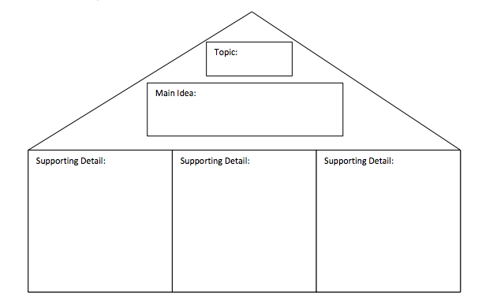
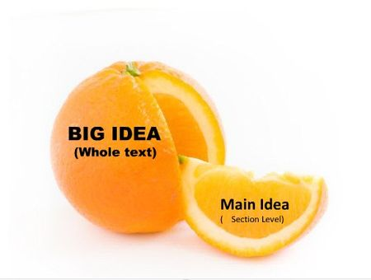
Main Idea

Slide 8
Identifying the Main Idea
Step 1
Ask yourself what is the passage mainly about?
Step 2
Sometimes the main idea is stated in the first (topic) or last (closing) sentence.
Step 3
Look for clue words that are repeated in the text.

Slide 9
Partner Work
Please Identify the main idea that the pictures represent.
Use the frame: I infer the main idea is________. I know this because___________

Slide 10
Mini-Lesson
We will echo read the passage together and then identify the main idea using our strategies.
On your white boards please write:
I infer the main idea is ______________. I know this because the supporting detail states________________________

Slide 11
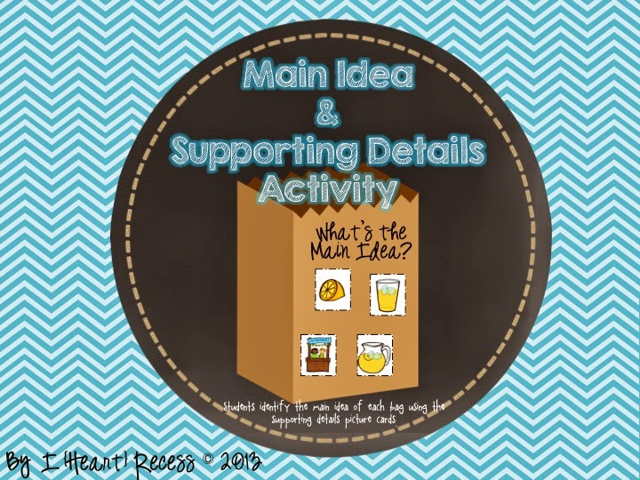
Group Work
Work with your child to complete questions
1-3.
Please remember to use your Main Idea Guiding sheet and move the paper clip as you complete each step!
Helpful Hint: Use the sentence frames to help you write your answers.

Slide 12
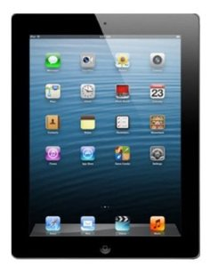
Survey/Review
Please complete the I-pad survey and hand your I-pad back to Mr. Warren.
Common Core Standards are consistent among states and build from grade to grade.
The Main idea is…..

Slide 13
Closing/Homework
How will you use this at home?
Homework- If your student turns in this completed form to room 34 by Wednesday February 25th they will receive a special prize.
Raffle

Slide 14
Questions?

