Slide 1

The Power of Parent Engagement in Schools.
By: Lisa Baggio

Slide 2

Principals Message to Parents:
I strongly urge all of you to get involved in any way you can. Please join the PTA, School Site Council, English Learner Advisory Council, volunteer in your child’s classroom, or volunteer around campus supporting teachers and staff to create a positive learning environment for all. We cannot do it without you so please get involved somehow!
Jenny Padilla

Slide 3
Topic and Rationale
Why Parent workshops…..
According to Yoder and Lopez(2013):
Parent Engagement
School
Engagement
Higher rate of Student success

Slide 4

English Language Learners
Marginalized Group: ELL’s both parents and students.
Why: 92.81% ELL’S
According to Niehaus and Adelson:
there is a Positive Correlation between parental involvement among ELL’s and student success.

Slide 5

Literature Review Findings:
Yoder and Lopez(2013)
“parental engagement in a child’s education has been supported by tons of literature to be important for the future success of children.”

Slide 6

Literature Review Cont’d
Barriers that prevent parents from attending school events:
Child-Care
Transportation
Time and Day
Translation
Anxiety

Slide 7
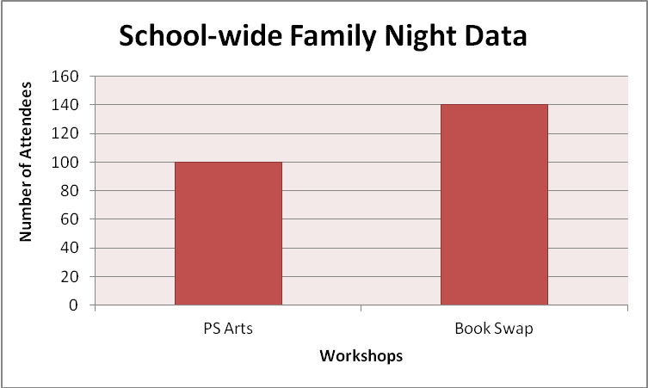
School Data
Among the 786 students, the following individuals attended the below school-wide events.

Slide 8
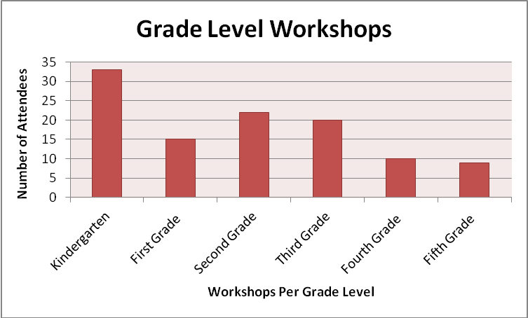
School Data Continued:

Slide 9


The Team
Team Lead
Lisa Baggio
Administrative Lead
Team members
Jeff Warren(AP)
Liz Ramos(LAS)
Jenny Padilla

Slide 10


The Timeline
January 14th | January 20 | February 18th | February 23 | April 8 | May 1-18 | May 20
PW 1-Inferenc-e based Skills | Analyze Surveys and draw Con. | PW 2- Reading Comp. Strat. | Analyze Surveys and draw Con. | PW 3-Writing Skills | Analyze results create plan for next year | Present to SSC

Slide 11
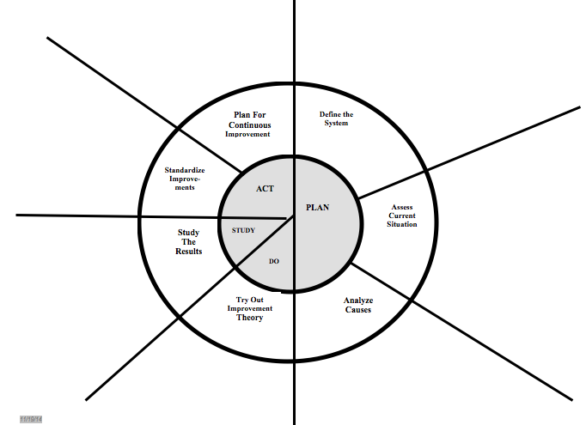
PDSA CYCLE 1-Grades 4 and 5 Only
Analyze Pre-Survey results with team
Present to SSC
Analyze/Plan
Plan inference based workshop
Workshop3/ Survey
Workshop 1/Survey
Analyze/Plan
Analyze/Plan
Workshop 2/Survey
Plan Workshop 2

Slide 12

Goals:
Short Term: More than 20% of Parents attend workshops 1-3 on ELA CCS in grades 4 & 5.
Medium Term: More than 20% of parents will attend on-going workshops with adding more grade levels.
Long Term: Parents will use the knowledge learned at the workshops to academically support their children.

Slide 13

References
Adelson, N. a. (2014). School Support, Parental Involvement, and Academic and Social-Emotional Outcomes for English Language Learners. American Educational Research Journal, 810-843.
Hoover-Dempsey, K. V. (2005). Why do parents become involved? Research findings and implications. The Elementary School Journal, 106, 105–130.
Jamie Rae Yoder, A. L. (2013). Parent's Perceptions of Involvement in Children's Education:Findings from a Qualitative Study of Public Housing Residents. Child and Adolescent Social Work Journal, 20.
Kirkner, J. O. (2014). The Impact of a Collaborative Family Involvement Program on Latino Families and Children’s Educational Performance . School Community Journal, 211-234.

Slide 14

Questions?
Thank you!

