Slide 1
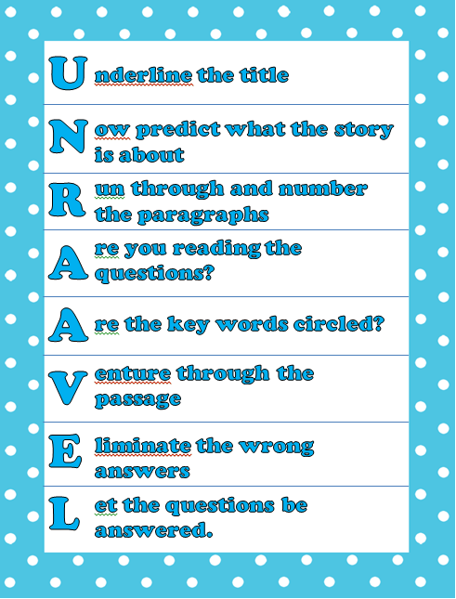
Reading Comprehension and Writing Strategies
By: Lisa Baggio
William Green Elementary
April 8, 2015

Slide 2
Common Core Standards
Purpose: Create a shared consistency in learning goals among different states.
46 states adopted the standards. New York has been working with standards for past 4 years.
They will promote college/career-ready culture
The standards from grade to grade are steps that build on one another to reach the top

Slide 3
Reading Standards-Grade 3
CCSS.ELA-LITERACY.RI.3.10 By the end of the year, read and comprehend informational texts, including history/social studies, science, and technical texts, at the high end of the grades 2-3 text complexity band independently and proficiently.

Slide 4
Reading standards Grade- 4
CCSS.ELA-LITERACY.RI.4.10 By the end of year, read and comprehend informational texts, including history/social studies, science, and technical texts, in the grades 4-5 text complexity band proficiently, with scaffolding as needed at the high end of the range.

Slide 5
Reading standards Grade-5
CCSS.ELA-LITERACY.RI.5.10 By the end of the year, read and comprehend informational texts, including history/social studies, science, and technical texts, at the high end of the grades 4-5 text complexity band independently and proficiently.

Slide 6
UNRAAVEL-Reading Comprehension strategy
Founded by Larry Bell over 20 years ago. Is proven to help students understand what they are reading and improve test scores
http://www.larry-bell.com/data-results-and-letters-of-testimony/
Helps students break down reading passages in a way that is fun and easier to understand.

Slide 7
Steps of UNRAAVEL
Underline the title.
Now predict the passage.
Run through & number the paragraphs.
Are you reading the questions?
Are the important words circled?
Venture through the passage.
Eliminate incorrect answers.
Let the questions be answered.

Slide 8
Independent work
Complete as many steps as possible with your child.
Cross out the letter as you complete the step.

Slide 9
UNRAAVEL reflection
Parents share out what they learned
How can you see using this strategy at home?
Answer sheet is in packet for you to check the answers at home after completing the hand-out.

Slide 10
3rd Grade Writing Standards
CCSS.ELA-LITERACY.W.3.10 Write routinely over extended time frames (time for research, reflection, and revision) and shorter time frames (a single sitting or a day or two) for a range of discipline-specific tasks, purposes, and audiences.

Slide 11
4th Grade Writing Standards
Write routinely over extended time frames (time for research, reflection, and revision) and shorter time frames (a single sitting or a day or two) for a range of discipline-specific tasks, purposes, and audiences.

Slide 12
5th Grade Writing Standards
CCSS.ELA-LITERACY.W.5.10 Write routinely over extended time frames (time for research, reflection, and revision) and shorter time frames (a single sitting or a day or two) for a range of discipline-specific tasks, purposes, and audiences.

Slide 13
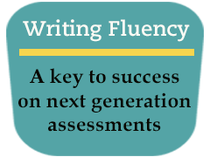
Power Writing
Power Writing was developed by National Writing project to build student’s writing fluency.
Writing fluency is the amount students can write over different periods of time.

Slide 14
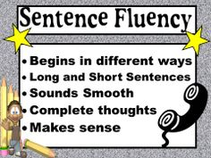
Steps of Power Writing
Put two topics on the board. Students can choose one topic.
Call on students to provide nouns, verbs, and or adjectives that describe the topic.
Example: Spring Break
Vacations
Have students close their eyes and visualize what they want to write.

Slide 15
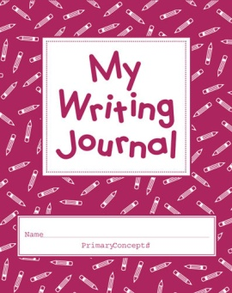
Power writing Steps Cont’d:
Have students write a goal of how many words that think they can write in the specified time period.
Students will then turn to a partner and share what they will write about
Have your students lift their pencils and say:
I am a writer ,I am a powerful writer I will write as much as I can As well as I can until the time is through!

Slide 16
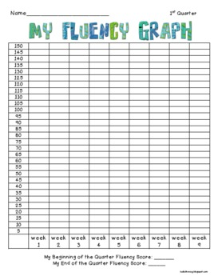
Power writing Steps Cont’d
Give the students between 3-5 minutes to write.
Have students count up their words and see if they met their goal.
Editing: Have the students do magic headphones editing-Put fingers in their ears and edit their work. You can give them an area to focus on.

Slide 17
Survey and Reflection
Review what did you learn from UNRAAVEL
What did you learn about Power Writing?
How will you use this at home?
Survey and Gift

Slide 18
Closing/Thank You!
Homework: Bring pack two reading passages with UNRAAVEL to room 34 by April 20th and receive a prize.
Questions?

