Slide 1
Gifted and Talented Identification
Presenter: Tammi Howard, GATE Coordinator
Fifty-Second Street Elementary School

Slide 2
Agenda
Define “Gifted” and “Talented”
Explain the goal of gifted and talented programs
Explore categories and required documentation
Engage in an Activity “Who Are They”
Examine 52nd Street Elementary’s Journey
Moving Forward
Notes:
“Who Are They” an activity built around the characteristics of GATE students specifically intellectually gifted students.

Slide 3
Office of Civil Rights (OCR)
GATE identification must reflect the demographics of a school and equity of access to GATE programs must be assured.
District policy requires school to seek out identify gifted and talented students from varying linguistic, economic and cultural background whose extraordinary capacities requires special services and programs. (Title V, California Code Regulation section 3820)
Evidence of a student’s capability shall consider the economic, linguistic, and cultural characteristics of students’ background. (Title V, California Code Regulation section 38203

Slide 4
How is “Gifted” and “Talented” Defined?
According to National Association for Gifted Children gifted and talented children is defined as “students children, or youths who give evidence of high achievement capability in such areas as intellectual, creative, artistic, or leadership capacity or in specific academic fields, and who need services or activities not ordinarily provided by the school in order to fully develop those capabilities”.
http://nagc.org/resource-publications/resources/definitions-giftedness#sthash.zCROtGPY.dpuf
No Child Left Behind Act, P.L. 107-110 (Title IX, Part A, Definition 22) (2002); 20 USC 7801(22) (2004)) - See more at: http://www.nagc.org/resources-publications/resources/definitions-giftedness#sthash.zCROtGPY.dpuf

Slide 5
What is the goal of Gifted and Talented Programs?
The goal is:
To identify gifted and talented students, including those from diverse racial, socioeconomic, linguistic, and cultural backgrounds, and provide high-quality differentiated opportunities for learning that meet students’ particular abilities and talents.
California Department of Education (CDE)

Slide 6
Los Angeles Unified School District identifies Gifted and Talented students in the following 7 categories:
1. Intellectual Ability
2. High Achievement
3. Specific Academic
4. Visual Arts
5. Performing Arts
6. Creativity
7. Leadership

Slide 7
Intellectual Ability
I.Q. Assessment – verbal & non-verbal
grades 2nd semester Kindergarten – 12
highly gifted possibility
Required Documentation:
Report Cards
CST Scores (2012 & 2013)
OLSAT Scores (if applicable)
Dibels
Student work samples
Teacher Recommendations (Refer to ….)
Notes:
Documents with GATE sentence stems...450 ELA (proficient) and 90th percentile of the advance category for math about 550.

Slide 8
High Achievement
Two consecutive years in BOTH ELA and Mathematics
Grades 4-12
OLSAT-8; taken in grade 2
No Documentation Required by the Teacher:
Data is collected in LAUSD’s System and recorded.
Considered by the District as “Slam Dunks”

Slide 9
Academic Specific
Three consecutive years in ELA OR Mathematics
grades 4-12
No Documentation Required by the Teacher:
Data is collected in LAUSD’s System and recorded.
Considered by the District as “Slam Dunks”

Slide 10
Activity: Who Are They?
I am going to read some descriptions/adjectives.
On the document provided, you are going to write down a student(s) who come to mind.
Notes:
Some potentially gifted learners may be able-underachieving and may not meet these criteria. These students should still be considered for referral if they show potential or demonstrate characteristics of
gifted learners in other ways. (highly verbal but produces minimum work; high interest

Slide 12
52nd Street Elementary School’s GATE Journey
We joined the Target Identification Program (TIP) in April of 2014.
SCHOOL NAME | TOTAL # IDENTIFIED GIFTED PRE TIP/ TOTAL # ENROLLED | TOTAL % IDENTIFIED GIFTED PRE TIP | TOTAL # STUDENTS TESTED (May 2014) First Round | TOTAL # STUDENTS IDENTIFIED + % IDENT | TOTAL % IDENT GIFTED POST TIP | TOTAL # IDENT GIFTED POST TIP
52nd Street ES | 12/904 | 1.3% | 26 | 16 (61.5%) | 1.9% | 17
At least 6% of the total population and of each ethnic subgroup should be as identified gifted. In addition, the Gifted identification must proportionately reflect the demographics of the school.
LAUSD Gifted and Talented Department

Slide 13
2nd Round of Testing 9/14 - 10/14
Approximately 53 students tested
35 students or approximately 66% were identified as “Intellectually Gifted”
Currently another 19 are being submitted for possible testing.

Slide 14
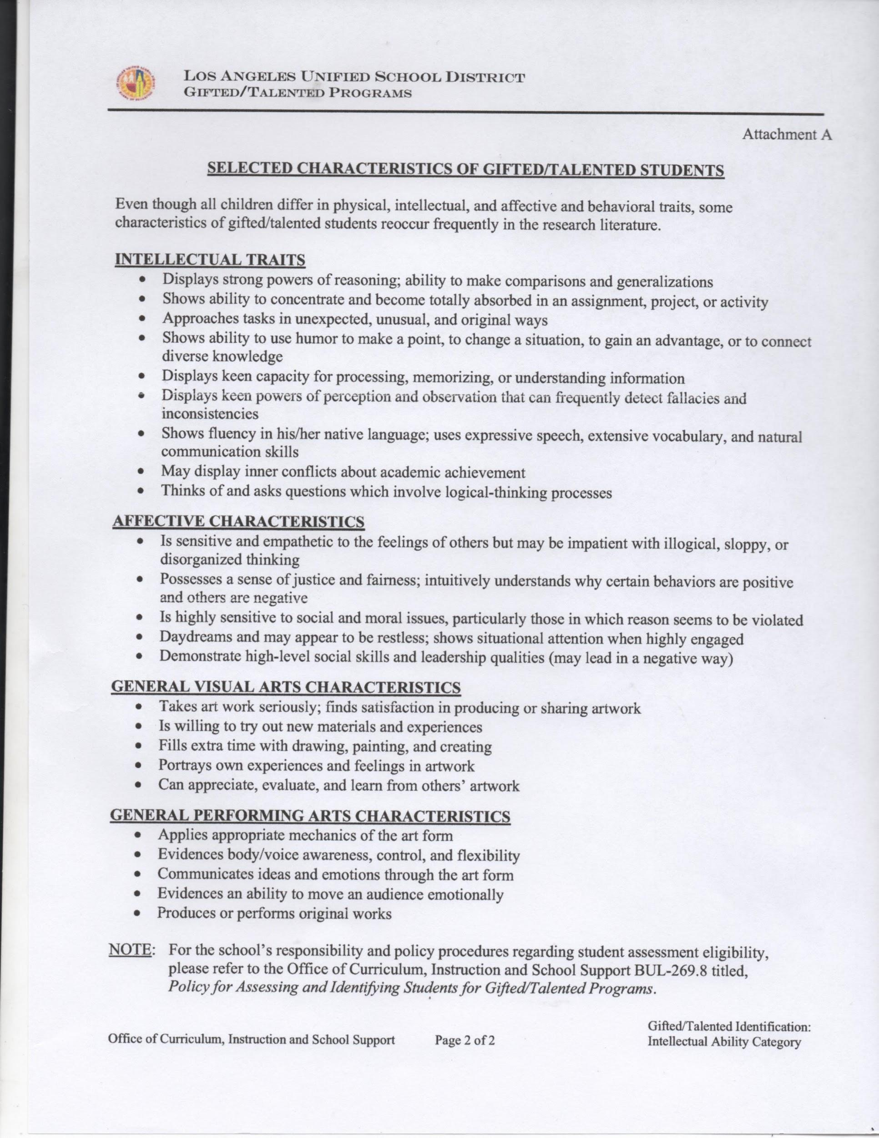
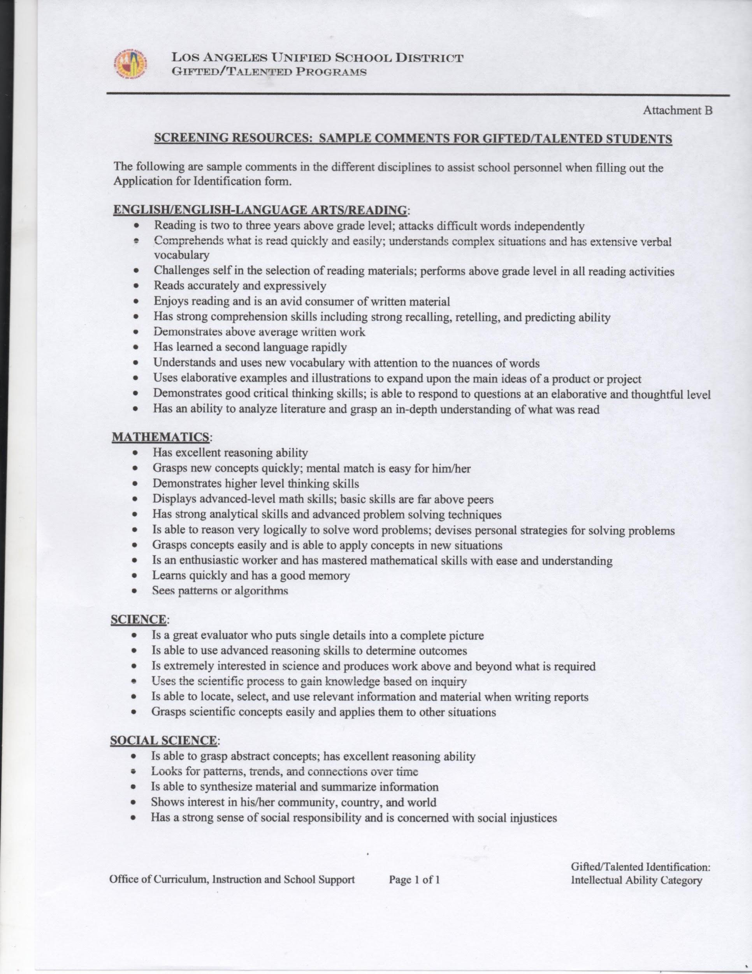
List of Gifted/Talented Characteristics and Sample Comments

Slide 15
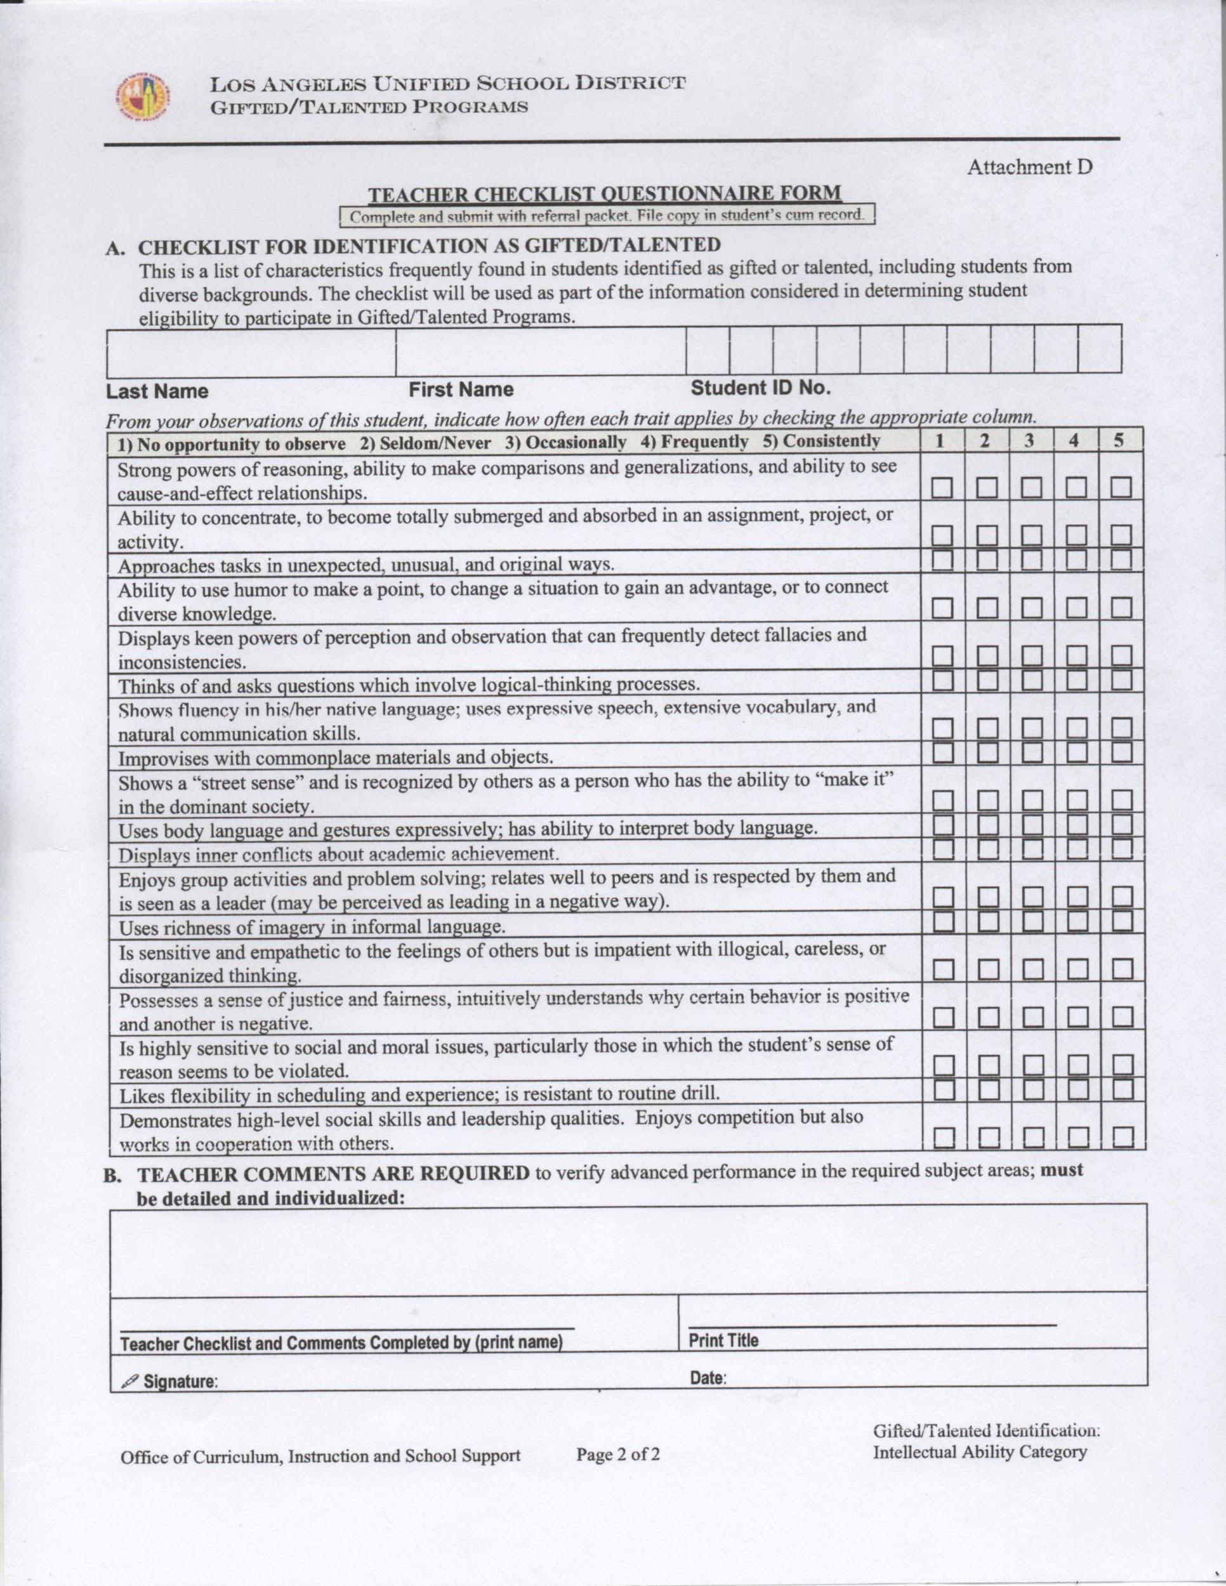
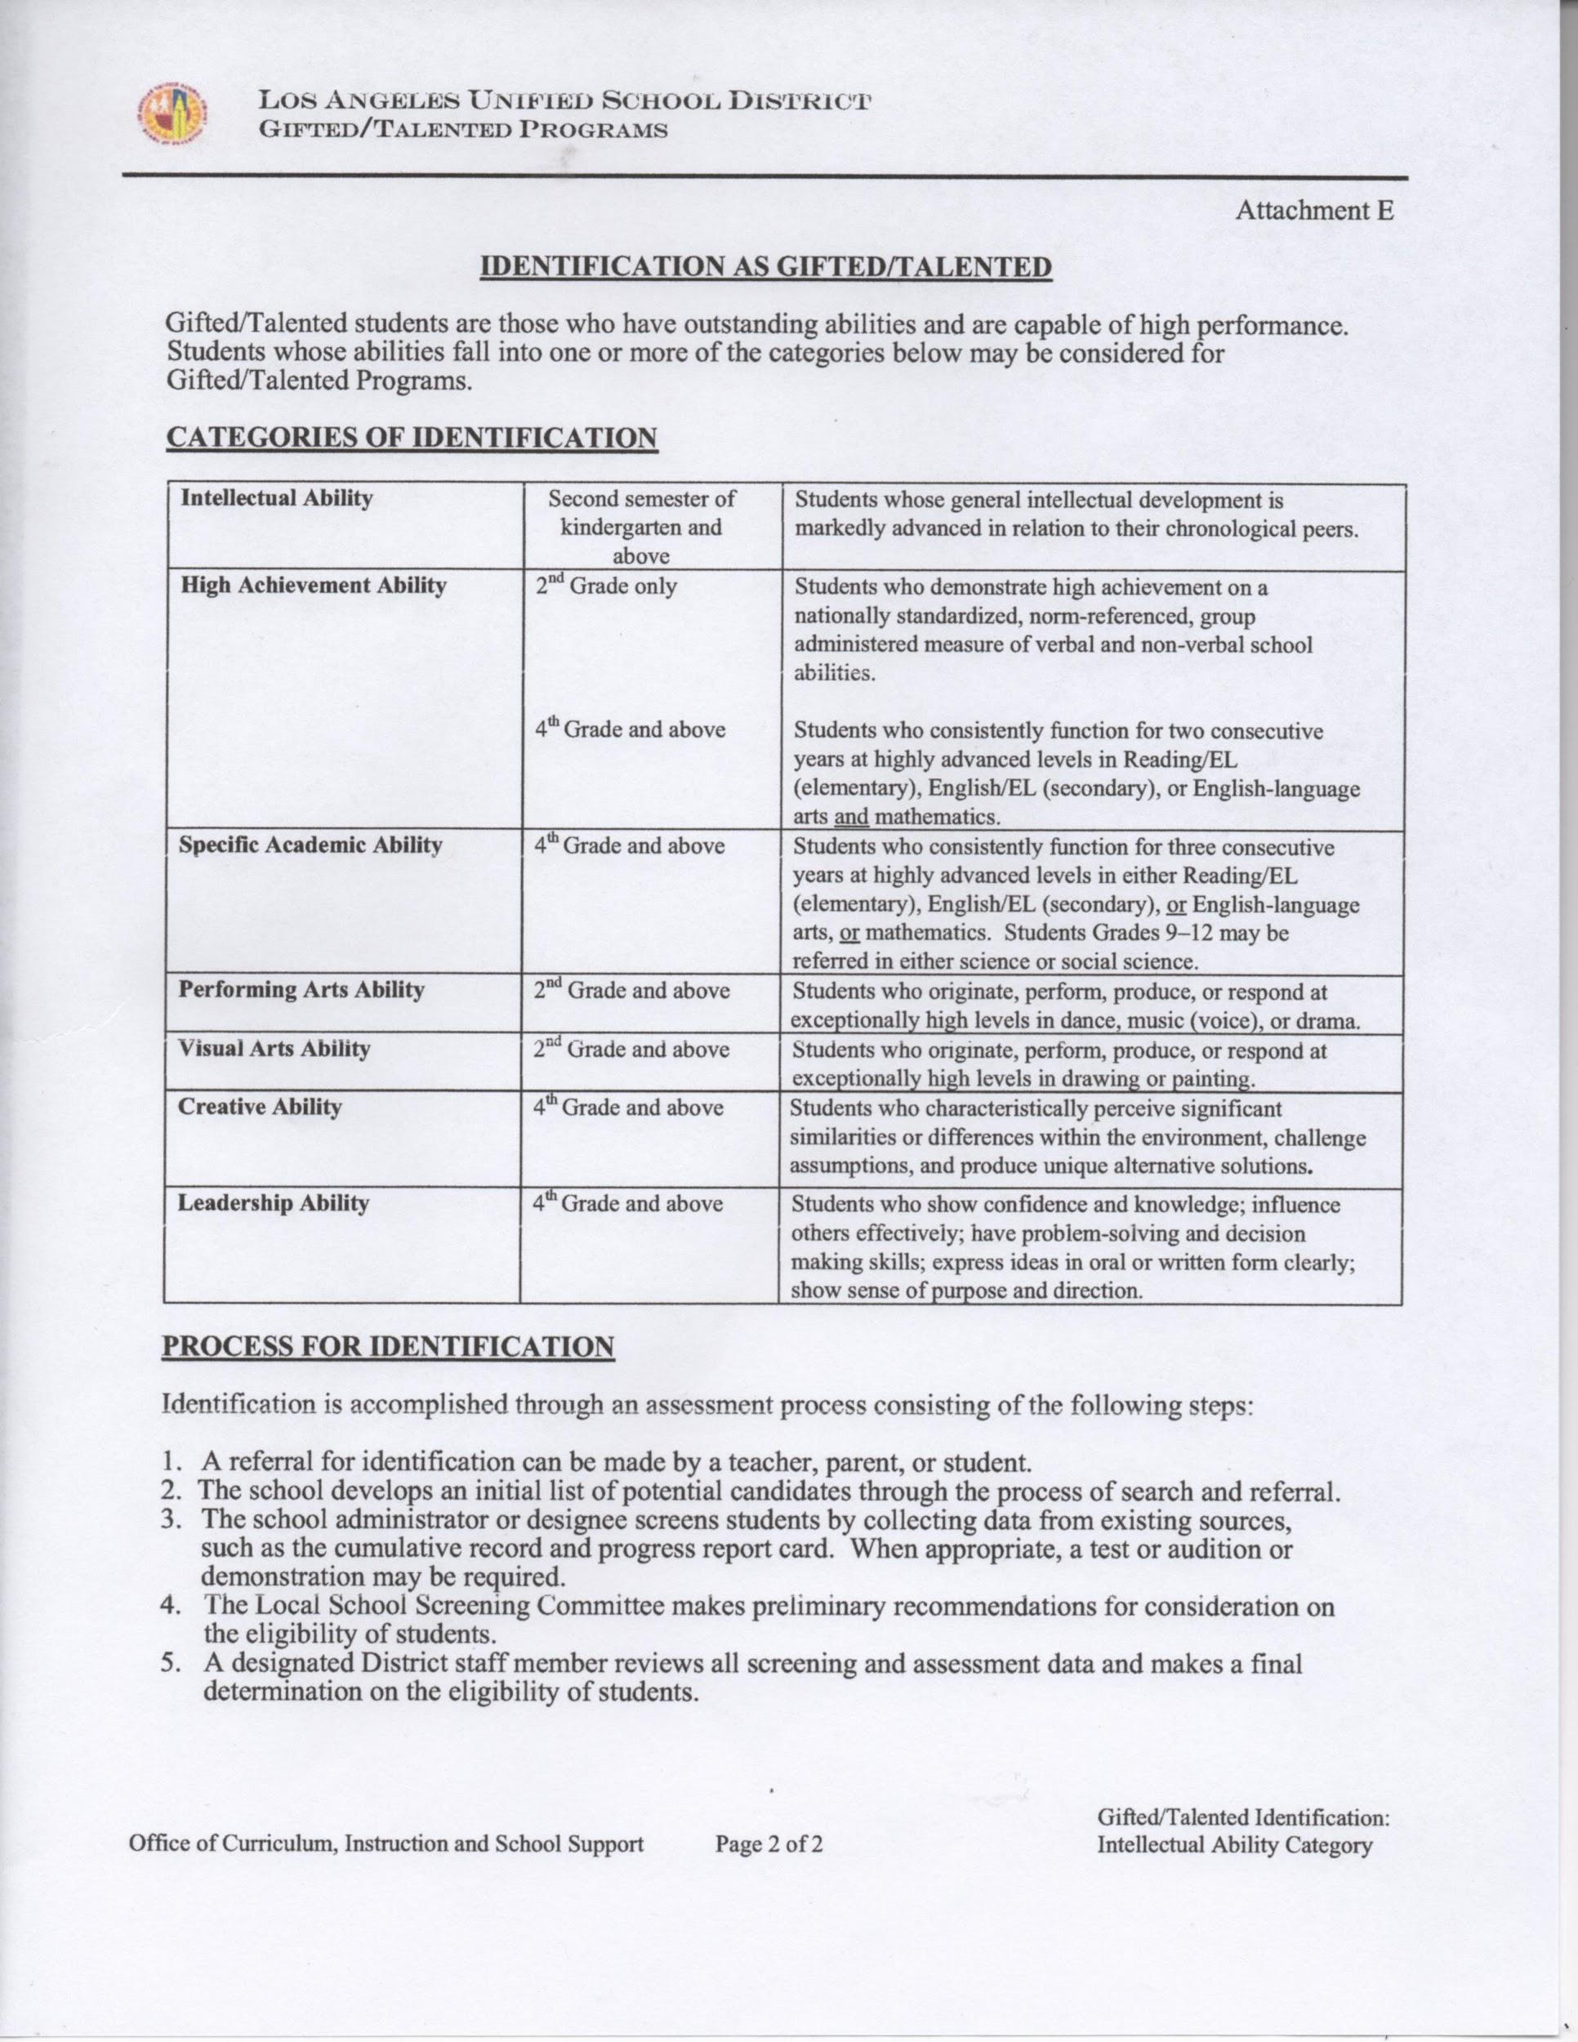
Teacher Questionnaire and Identification Sheet

Slide 17
Final thoughts...
It is our responsibility to ensure that ALL of our students have access to educational opportunities that help them meet their academic, intellectual, social, and emotional potential.

Slide 18
Final Thoughts Con’t
“WHAT MAKES A CHILD GIFTED AND TALENTED MAY NOT ALWAYS BE GOOD GRADES IN SCHOOL, BUT A DIFFERENT WAY OF LOOKING AT THE WORLD AND LEARNING.”
CHUCK GRASSLEY

Slide 19
Thank you for supporting this process and believing in the children we serve! Without you, these accomplishments would not have been possible!!!
Please fill out the reflection form before you leave.

