Slide 1
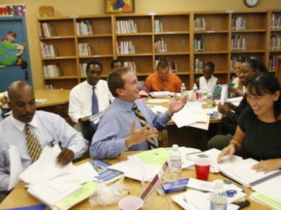
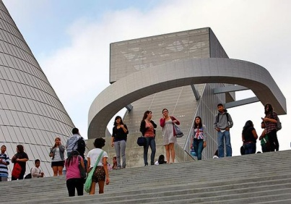
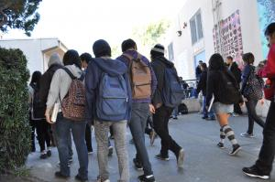
Doing Math: Rich Problem Solving Tasks-Grade 4 and 5
Joseph Espinosa, NBCT
CCSS Math Facilitator
Garvanza Elementary
October 13, 2014

Slide 2
Like Me
I need coffee in the morning
I like to go to San Diego or the Bay Area
My phone service is AT&T
I have vacation plans Thanksgiving or Winter Break
I know exactly how many days till Winter Break
I am a foodie.
I am a UCLA Bruin!
Notes:
Like Me –Day 2 (3 Minutes)
Maria
Outline of Activity/Notes to Consider:
Say:

Slide 3
ISIC Learning Norms
Assume positive intent
What is learned here leaves here
Be fully present - start and end on time; silence electronics
Listen to understand; honor all voices; invite different perspectives
Be open to new ideas
Support one another’s learning
Watch (share) air time
Notes:
Review the learning norms (established by ISIC Instructional Directors)

Slide 4
Teaching Math Through Problem Solving

Slide 5
Session Outcomes
To strengthen our content and pedagogical knowledge around a domain or cluster of standards that falls within one of the critical areas.
To identify the CCSS Content and Practice Standards for a problem solving task.
To utilize the CA Math Framework as a tool to better understand the CCSSM Standards.
To become familiar with alternative sources for CCSSM problem solving tasks.

Slide 6
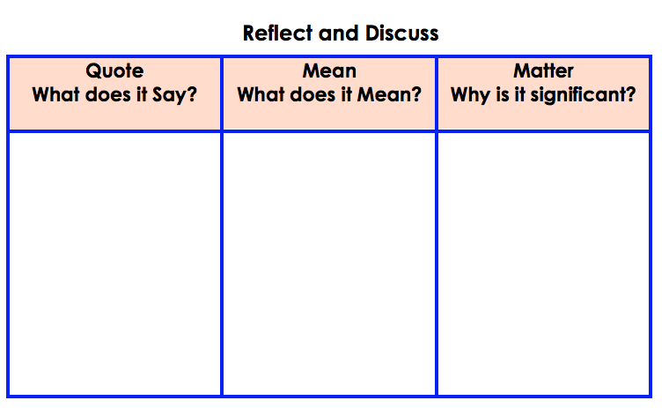
Independent Reading Activity
“Why Do Americans Stink at Math?”-NY Times
Read bottom of page 4 to the top of page 9
Keep the following questions in mind, feel free to use your answers from the reflection questions:
What does the text say?
What does it mean?
Why does it matter?
Fill in the “Say, Mean, Matter” chart
Notes:
Notes: Go over the Say Mean Matter Chart Questions and use TAG/TAU to ensure and understanding of the text.

Slide 7
Share Out
Notes:
Participants share with a Partner first for 5 minutes then a whole group share out (2-3 volunteers)

Slide 8
CCSS Connection
Asking a student to understand something means asking a teacher to assess whether the student has understood it. But what does mathematical understanding look like? One hallmark of mathematical understanding is the ability to justify, in a way appropriate to the student’s mathematical maturity, why a particular mathematical statement is true….…Mathematical understanding and procedural skill are equally important, and both are assessable using mathematical tasks of sufficient richness.
By engaging in a task, teachers will have the opportunity to consider the potential of the task and engagement in the task for helping learners develop the facility for expressing a relationship between quantities in different representational forms, and for making connections between those forms.
Common Core State Standards for Mathematics, 2010

Slide 9
English Learner Master Plan
English Learner Master Plan, 2012,
Pages 2-3
Master Plan Guiding Principles
English Learners (ELs) are held to the same high expectations of learning established for all students.
ELs develop full receptive and productive proficiencies in English in the domains of listening, speaking, reading & writing.
ELs are taught challenging academic content that enables them to meet performance standards in all content areas.
ELs receive instruction that builds on their previous education and cognitive abilities and that reflects their language proficiency levels.
ELs are evaluated with appropriate and valid assessments that are aligned to state and local standards and that take into account the language development stages & cultural backgrounds of the students.
The academic success of ELs is a responsibility shared by all educators, the family and the community.
Notes:
Please present the following:
Objectives-Goal Setting
Connect Policy to Practice (Master Plan, Memo, Reference Guide or Bulletin)
Add Talking Points to assist all presenters with the thinking behind the creation of this slide.

Slide 10
Notes:
Please present the following:
Objectives-Goal Setting
Connect Policy to Practice (Master Plan, Memo, Reference Guide or Bulletin)
Add Talking Points to assist all presenters with the thinking behind the creation of this slide.

Slide 11
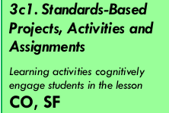
ISIC Instructional Focus Elements

Slide 12
Session Outcome 1
To identify the CCSS Content and Practice Standards for a problem solving task.

Slide 13
Salty Pretzels Task-Grade 4
Notes:
Doing Math (45 Minutes)
Brian
Refer to handout 1
Introduce task, everyone has a copy:
Solve independently
Discuss with table and create poster to represent solutions
Facilitator selecting work for SDA
SDA

Slide 14
Salty Pretzels Task-Grade 4
Notes:
Doing Math (45 Minutes)
Brian
Refer to handout 1
Introduce task, everyone has a copy:
Solve independently
Discuss with table and create poster to represent solutions
Facilitator selecting work for SDA
SDA

Slide 15
Art Tasks-Grade 5

Slide 16
Art Tasks-Grade 5

Slide 17
Expectations for Group Discussion
Solution paths will be shared.
Listen with the goals of:
putting the ideas into your own words;
adding on to the ideas of others;
making connections between solution paths; and
asking questions about the ideas shared.
The goal is to understand the mathematics and to make connections among the various solution paths.
Notes:
Directions:
Read the directions to participants.

Slide 18
Salty Pretzels Task-Grade 4 Art Task-Grade 5
Notes:
Doing Math (45 Minutes)
Brian
Refer to handout 1
Introduce task, everyone has a copy:
Solve independently
Discuss with table and create poster to represent solutions
Facilitator selecting work for SDA
SDA

Slide 19
Discuss the Task (Whole-Group Discussion)
How do you know that Mary does not have enough salt remaining for Friday? How much more salt does Mary need so that she will not need to go to the market?
What connections can be made between the different solutions used to determine whether Mary had enough salt?
What are the different ways we can find the area of this space on the wall?
What is tiling? How does multiplication relate to tiling?
How is the multiplication of fraction (rational numbers) the same and different than multiplying whole numbers?
Notes:
Directions:
Engage participants in the Share, Discuss and Analyze Phase of the Lesson. Focus the discussion on key mathematical idea related to the standards.
Decomposing a Fraction
Where is each of the amounts on the number line and how do you determine where to place them.
Locating Amounts on the Number Line
Where is each of the amounts on the number line and how do you determine where to place them. How do you know to place some closer to each other than others?
Lizbeth chewed 3/5 of her gum. Two and a half pieces would be half. All of the others are closer to one. They are both one piece from the whole and the pieces are a lot smaller.
Some people made separate number lines for each of the amounts. Why did you do this? Let’s look at this representation and see what can be learned by doing this?
How can I use the unit fraction to reason about 5/6 and 3/4? What do you know about 1/6
And 1/4 and then about 5/6 and 3/4 that helps you determine which is more. Both are one
piece away from one so how do you make this decision?
What do you know about 1/6 and about 1/4? (Pieces that are fourths are bigger than pieces that are sixths)
So why is 5/6 more than 3/4 then if the pieces are smaller? (Record 1/6 + 1/6 + 1/6 + 1/6 + 1/6 = 5/6 on the board with 1/4 + 1/4 + 1/4 = 3/4 under the first equation. There are two more of the smaller pieces. If you think about 12^{ths}, there would be 3/12 or 2/12 (Mark that this person has made equivalent pieces for a subset of the pieces. Is this okay to do? Flexible thinking and reasoning.)

Slide 20
Sharing Our Thinking
What mathematics did we use to complete this task?
Notes:
Debrief Doing Math
Brian
As a table answer these questions
Turn to your partner
Talk as a table
be ready to share whole group
Chart: Questions to record responses

Slide 21
Essential Understandings-Salty Pretzel Task Grade 4
Adding and subtracting fractions is joining and separating parts.
Equivalent fractions have the same value.
A mixed number is a whole number and a fractional part which can be written as a fraction with a numerator greater than the denominator.
Fractional numbers and mixed numbers can be added and/or subtracted.
When adding/subtracting fractions with the same denominator, numerators are added/subtracted but the denominator remains the same.
Fractions representing the same size pieces (common denominators) from the same size whole, can be combined and only the number of the pieces (the numerator) will need to be considered.
Fractions representing the same size pieces (common denominators) from the same size whole, can be compared to each other because the size of the pieces is the same.

Slide 22
Essential Understandings-Art Task Grade 5
Each multiplicative expression developed in the context of a problem situation has an accompanying explanation, and different representations and ways of reasoning about a situation can lead to different expressions or equations.
The interpretations of the operations on rational numbers are essentially the same as those on whole numbers, but some interpretations require adaptation, and the algorithms are different.

Slide 23
Session Outcome 2
To identify the CCSS Content and Practice Standards for a problem solving task.

Slide 24
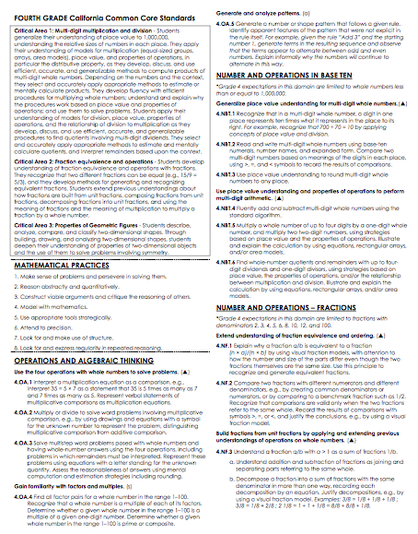
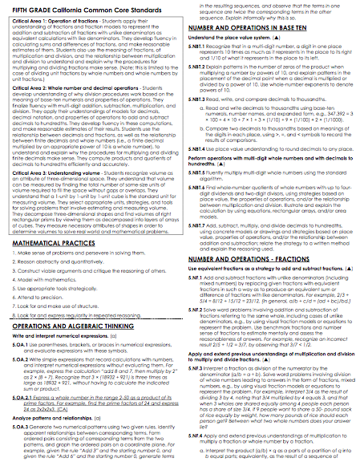
Common Core 1-Pagers
In pairs or triads discuss the following question using the Common Core 1 Pager for your grade level:
Which of the CCSS for mathematical content did we discuss?

Slide 25
Salty Pretzels Task-Grade 4
Common Core Math Content Standards
Common Core Domain: Number and Operations -Fractions
Common Core Cluster: Build fractions from unit fractions by applying and extending previous understandings or operations on whole numbers.
Focus Standards:
4.NF.3a: Understand addition and subtraction of fractions as joining and separating parts referring to the same whole
4.NF.3c: Add and subtract mixed numbers with like denominators, e.g., by replacing each mixed number with an equivalent fraction, and/or by using properties of operations and the relationship between addition and subtraction.
4.NF.3d: Solve world problems involving addition and subtraction of fractions referring to the same whole and having like denominators, e.g. by using visual fraction models and equations to represent the problem.
Notes:
Doing Math (45 Minutes)
Brian
Refer to handout 1
Introduce task, everyone has a copy:
Solve independently
Discuss with table and create poster to represent solutions
Facilitator selecting work for SDA
SDA

Slide 26
Art Task-Grade 5
Common Core Math Content Standards
Common Core Domain: Number and Operations - Fractions
Common Core Cluster: Apply and extend previous understandings of multiplication and division to multiply and divided fractions.
Focus Standards:
5.NF.4a: Interpret the product (a/b) × q as a parts of a partition of q into b equal parts; equivalently, as the result of a sequence of operations a × q ÷ b. For example, use a visual fraction model to show (2/3) × 4 = 8/3, and create a story context for this equation. Do the same with (2/3) × (4/5) = 8/15. (In general, (a/b) × (c/d) = ac/bd.)
5.NF.4b: Find the area of a rectangle with fractional side lengths by tiling it with unit squares of the appropriate unit fraction side lengths, and show that the area is the same as would be found by multiplying the side lengths. Multiply fractional side lengths to find areas of rectangles, and represent fraction products as rectangular areas.
Notes:
Doing Math (45 Minutes)
Brian
Refer to handout 1
Introduce task, everyone has a copy:
Solve independently
Discuss with table and create poster to represent solutions
Facilitator selecting work for SDA
SDA

Slide 27
Bulleted Standards for Math Practice
In pairs or triads discuss the following question using the Bulleted CCSSM Practices Handout:
Which of the CCSS mathematical practices did you use when solving the task?

Slide 28
Salty Pretzels Task-Grade 4
Common Core Math Practice Standards:
MP.1-Make sense of problems and persevere in solving them.
MP.2-Reason abstractly and quantitatively.
MP.3-Construct viable arguments and critique the reasoning of others.
MP.4-Model with mathematics.
MP.6-Attend to precision.
MP.7-Look for and make use of structure.

Slide 29
Art Task-Grade 5
Common Core Math Practice Standards:
MP.1-Make sense of problems and persevere in solving them.
MP.2-Reason abstractly and quantitatively.
MP.3-Construct viable arguments and critique the reasoning of others.
MP.4-Model with mathematics.
MP.6-Attend to precision.
MP.7-Look for and make use of structure.

Slide 30
Session Outcome 3
To utilize the CA Math Framework as a tool to better understand the CCSSM Standards.

Slide 31
Using the California Math Framework to Deepen Content Knowledge

Slide 32
Where to Find It
View the new
Mathematics Framework online at
http://www.cde.ca.gov/ci/ma/cf/
or
Google “California Math Framework”
Notes:
The pre-publication version of the Framework is currently available online as a word document until there is a published document to replace it.
The Framework will be published in its final form Summer 2014. The content will not change.

Slide 33
Goals for the CA Mathematics Framework
Guide the field in implementation
Emphasize coherence across and within grade levels
Integrate the standards for Practice and Content
Provide guidance on the higher mathematics course progression
Notes:
•The primary goal for the new Mathematics Framework is to guide the field, especially classroom teachers, in their implementation of the California Common Core State Standards for Mathematics (CA CCSSM).
•The Framework emphasizes the coherence of mathematical content across grade levels and between major topics within grade levels.
•Integrating the Standards for Mathematical Practice with the Standards for MathematicalContent is another focus of the Framework. Many of the example problems include notations about which Mathematical Practice (MP) Standards studentswill apply to solve a problem or complete a task.
•The new Framework also provides course options for higher mathematics—including integrated mathematics courses, courses in the traditional pathway, and more advanced mathematics.
•Throughout the writing of the Framework the developers kept in mind one essential question—Does this help teachers to instruct and students to learn the California Common Core State Standards?

Slide 34
California Math Framework
Grade 4: Read Number and Operations-Fractions, lines 382-431
Grade 5: Read Number and Operation-Fractions, lines 353-404
Annotate with
* Agree
? Question
! Ah-ha

Slide 35
California Math Framework
4th & 5th Grade Standards for Mathematical Content
What connections can you make between what we read in the CA Framework and what the task required?
What new insights do you have about the domain of Numbers and Operations-Fractions?
Notes:
CA Math Framework (15 Minutes) continued
Joseph
Refer to handout 2
Outline of Activity/Notes to Consider: Have participants read 253-318 from the CA Math Framework
Use the Visual Paragraph Strategy when explaining the task
Expert Groups
After 6 minutes, have participants share at their table groups key points and any connections to the math task.
What connections can you make between what we read in the CA Framework and what the task required?
What new insights do you have about the domain of Counting and Cardinality?
Say “What questions might you have about this task?”

Slide 36
Session Outcome 4
To become familiar with alternative sources for CCSSM problem solving tasks.

Slide 37
Session Outcomes
To strengthen our content and pedagogical knowledge around a domain or cluster of standards that falls within one of the critical areas.
To identify the CCSS Content and Practice Standards for a problem solving task.
To utilize the CA Math Framework as a tool to better understand the CCSSM Standards.
To become familiar with alternative sources for CCSSM problem solving tasks.

Slide 38
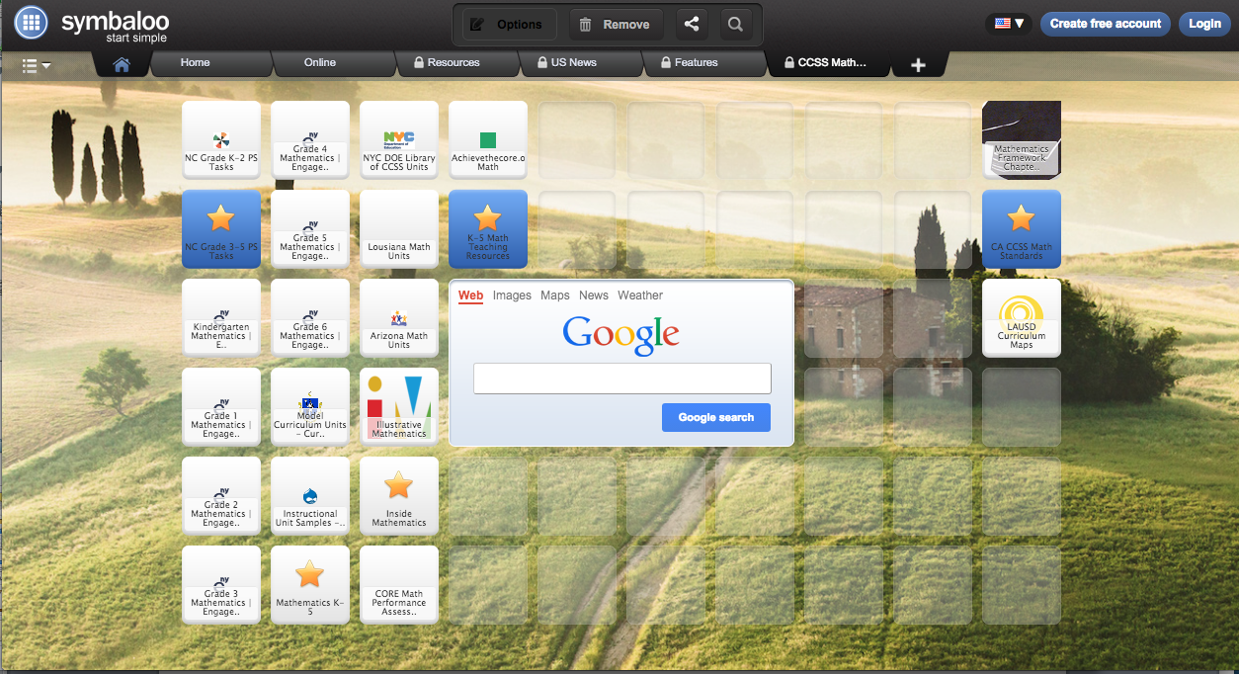
CCSS Math Resources
www.symbaloo.com/mix/ccssmathresources1
Notes:
Links to resources, district and outside, for all grades and all subjects related to CCSS Math Resources have been gathered on our Symbaloo mix.

Slide 39
Evaluation
http://bitly.com/isicfeedback

Slide 40
Contact Information
Joseph Espinosa-jae0598@lausd.net

Slide 41
Thank You!

