Slide 1
Got Systemness? Using a Logic Model to Bridge Formative Assessments and Smarter Balance Assessment
Katie McGrath
Joseph Espinosa
January 28, 2015
Notes:
We just heard about SBAC which is only one of a number of assessment in place at a school site and it is high stakes and coming soon. This learning experience is meant to look at assessment at a school site as a system. SBAC is one part of that system but there will be other assessments in play. An effective assessment system will have other assessments measuring learning for different purposes, at different times, and in different forms . My time with you is to get you thinking about if those other types of assessments are in place with the structures for deconstructing the assessments and predicting the learning to occur, analyzing the student work which was captured by the assessment, and communicating that data with different purposes to different audiences.

Slide 2
Circle Map
Systems for regular formative assessment cycles that bridge to the SBA targets

Slide 3
Grounding: Rick Stiggins on Assessment Leadership

Slide 4
Balanced Assessment System
Balanced Assessment System
Classroom Level Assessments
Program-Level Assessments
Institutional Accountability and Policy Level Assessments
Notes:
Classroom level assessments: help students, teachers, and sometimes parents make their instructional decision. These are the daily formative assessment (formal or informal) that provide formative feedback. Stiggins and Duke (2008) note that this level of data is perhaps the most important level for administrators, other leaders, and teachers wishing to make changes in their school.
Program-level assessments: used by everyone at the school level, including but not only by administrators, school and teacher leaders, teachers, and instructional leadership teams. These data allow those at the school level to examine and evaluate across multiple classrooms and work to improve school programming (school wide instructional practice).

Slide 5
Balanced Assessment System
Classroom Level (Formative at the classroom level) (Not used for grades) | Program Level (Formative or Summative at the school Level) (Can be used for grades) | Institutional Accountability/Policy Level (Summative)
quizzes | SBAC Interim Assessments | SBAC
Anecdotal observations | Publish or Teacher created unit assessments | NAEP
questions | On-demand writing | CELDT
tasks | Performance task | PISA
Quick-check/exit tickets | Common Assessment Designed by PLC

Slide 6
Right Drivers Vs. Wrong Drivers
Non-Lead Drivers | Lead Drivers
Focus on individual employee quality | Focus on group quality
Focus on accountability | Focus on building capacity
Focus on technology | Focus on instruction
Fragmented strategies | Systemic strategies

Slide 7
Improving Systems
Notes:
Not every change leads to improvement.

Slide 8
Notes:
The Plan Deliver Revise Reflect Cycle is an example of this more general PDSA Cycle

Slide 9
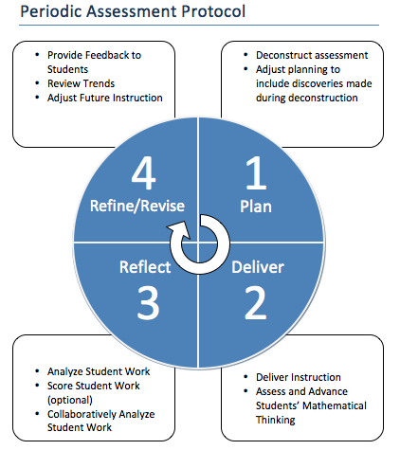
Formative Assessment Cycle
Notes:
All the common core implemention items including 2+1 and our menus use this inquiry model of planning.

Slide 10
Notes:
Changes that result in improvement take multiple improvement cycles and increase in scale. Maybe start with one grade level or department and scale up. Each Formative Assessment Cycle is an improvement cycle for students and teachers.

Slide 11
Logic Model
SBAC
Interim
Assessments
Data
SBAC Data
Exit Ticket
Data
Notes:
Logic model is a…
Picture of your program or intervention or system
Graphic representation of the “theory of action” – what is invested, what is done, and what results
Core of planning and evaluation
Inputs: People, resources
Outputs
Activities: PDs on Formative Assessment , SBAC Claims and Targets, All phases of formative assessment cycle calendared, Communicating of Data to various stakeholders.
Participation: Who and what role

Slide 12
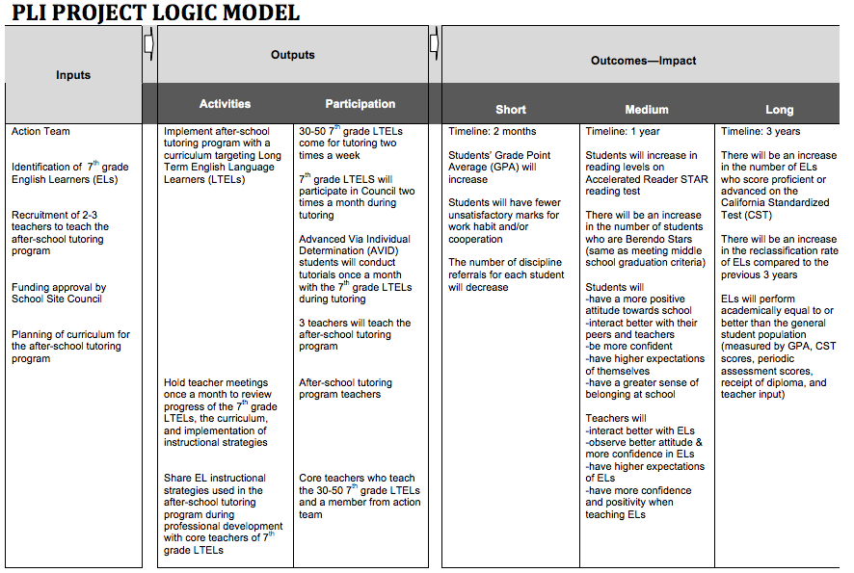
Planning
Evaluation
Notes:
Planning: Start with the end in mind
Evaluation: Check and verity

Slide 13
Writing good outcomes
SMART objectives: Specific, measurable, attainable, results-oriented, timed
Who/what | Change/desired effect | In what | By when
Families participating in the Family Resource Center | increase | their use of community resources and services | within one year of joining
4 school boards | adopt | policies to improve student nutrition and physical activity | by Dec 2005
Notes:
Very important point about writing outcomes. An outcome needs all of these components.

Slide 14
The Final Word aka “Save the Last Word for Me”
Step1: Individually write 1 long term outcome(1 year) or short term outcome (9 weeks or 12 weeks)
Step 2: In groups of 4 using the Final Word Protocol:
1 person shares their outcome (1 minute)
Everybody else in turn responds with comment or feedback (1 minute each)
The person that began has “the final word”to respond to what was said, to share what they are thinking now, or to clarify any confusion

Slide 15
Thank You!
“Assessment systems must provide a variety of decision makers with a variety of different kinds of information in different forms at different times to support or to verify student learning.“-Rick Stiggins and Dan Duke (2008)

