Slide 1
Interim Assessment & Data Analysis
Collin Felch
Annick Draghi
Joseph Espinosa
December 10, 2014

Slide 2
Notes:
Collin

Slide 3
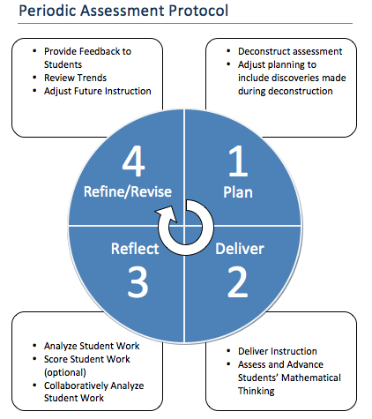
Formative Assessment Cycle
Notes:
Collin

Slide 4
Notes:
Joseph
Where is Your School on the Formative Assessment Cycle with Respect to the District Interim Assessments? https://www.polleverywhere.com/free_text_polls/1pEP1K00TOk0JHe

Slide 5
Gots and Wants
Gots
Wants
What has your school already done?
What do you already know about the interim assessments?
What does your school still need to do?
What do you still want/need to learn about the interim assessments?
Notes:
Collin
Slide Title (2 minutes)
Purpose:
Get feedback from participants after Day 1.
Outline of Activity/Notes to Consider:
Create a poster where teachers can place their post-its as they leave for the day.
Say: “As you think back over the day’s activities, on your post-it notes please write something you got from the session. On a separate post-it, please write something you want from tomorrow’s session. We will review the Gots and Wants at the end of the day to help us in preparing for tomorrow.”

Slide 6
Formative Assessment Cycle
Notes:
Joseph

Slide 7
Analyzing Student Work Protocol Video
https://www.teachingchannel.org/videos/protocol-for-evaluating-lessons-equip#
Notes:
Joseph

Slide 8
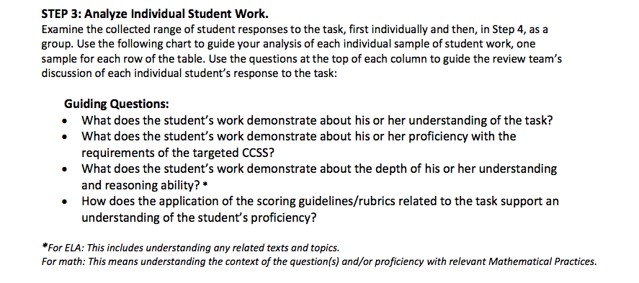
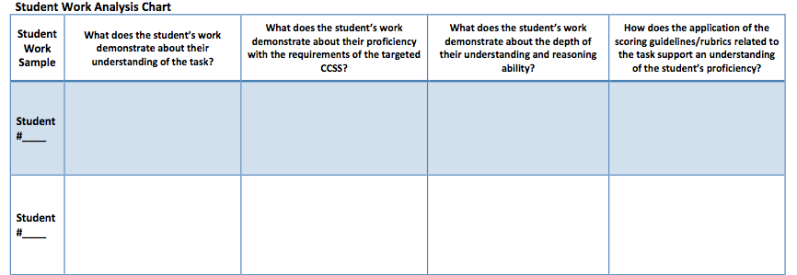
Step 3: Analyze Individual Student Work
Use the chart to guide the analysis of each individual student work sample.
Use the guiding questions to facilitate the group discussion.
Notes:
Collin

Slide 9
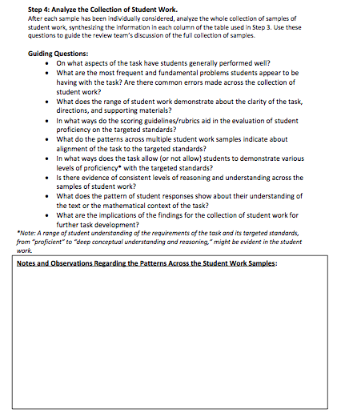
Step 4: Analyze the Collection of Student Work
Analyze the whole collection of student work samples, synthesizing the information in each column of the table in the last step.
Use the guiding questions to facilitate the group discussion.
Notes:
Collin

Slide 10
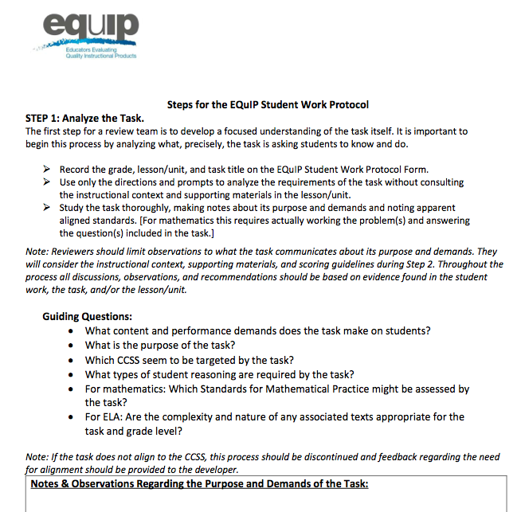
Step 1: Analyze the Task
Purpose: To develop a focused understanding of the task.
Process: Using guiding questions analyze and record what precisely the task is asking students to know and do.
Notes:
Joseph

Slide 11
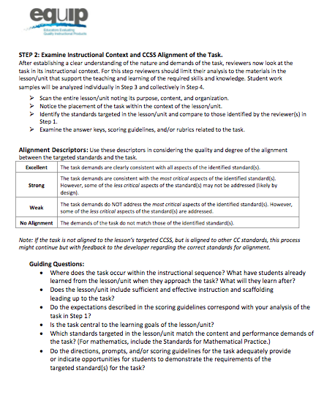
Step 2: Examine Instructional Context & CCSS Alignment of the Task
Purpose: To look at the task in its instructional context.
Process: To analyze the materials in lessons/unit that support the teaching and learning of the required skills and knowledge.
Notes:
Joseph

Slide 12
SBAC Interim Assessments
Coming in January/February
Computer-based (like the actual SBAC)
Interim Comprehensive Assessments vs. Interim Assessment Blocks
Notes:
Annick

Slide 13
Formative Assessment Cycle Support Using EQuIP Student Work Protocol
PD Support and Follow-Up Offerings
Analysis of Interim Assessment Task(s) with EQuIP Student Work Protocol
Theory of Action for Instruction using a SMART Goal Template
Analysis of Individual & Classroom Level Student Work using EQuIP Student Work Protocol
Notes:
Joseph

Slide 15
Contact
Collin Felch- collin.felch@lausd.net
Joseph Espinosa jae0598@lausd.net

