Slide 1
Elementary CCSSM Menu of Services
Joseph Espinosa
August 21, 2014

Slide 2
Vision
ISIC elementary schools will be led by professional teacher practitioners who with a deep understanding of the CCSSM Standards of Content and Practice are able to plan and execute rigorous lessons and units which embed in meaningful ways technology and formative assessment while also demonstrating a high quality of instructional practice that emphasizes conceptual understanding (TLF 3c1) , collaboration, and academic discourse (TLF 3b1, 3b2) , with a focus on constructing viable arguments.

Slide 3
SMART Goal #1
By May 2015, 50% of teachers are teaching math through a problem solving, student-centered approach as measured by observation and evidenced by teachers using a three-phase or CGI problem solving lesson structure.

Slide 4
SMART Goal #2
By May 2015, 100% of teachers will have planned together in grade level teams a CCSS standards-based unit of rigorous lessons and completed a lesson study or analyzed student work via plan/deliver/reflect/revise cycle* in ELA and math as measured by the PD tracker.

Slide 7
The duration of professional development must be significant and ongoing to allow time for teachers to learn a new strategy and grapple with the implementation problem.

Slide 8
There must be support for a teacher during the implementation stage that addresses the specific challenges of changing classroom practice.

Slide 9
Teachers’ initial exposure to a concept should not be passive, but rather should engage teachers through varied approaches so they can participate actively in making sense of a new practice.

Slide 10
Modeling has been found to be a highly effective way to introduce a new concept and help teachers understand a new practice.

Slide 11
The content presented to teachers shouldn’t be generic, but instead grounded in the teacher’s discipline (for middle school and high school teachers) or grade-level (for elementary school teachers).

Slide 12
A PD Series
PD Experience
Implementation
Feedback
(1-4 Weeks)
PD Experience
Implementation
Feedback
(1-4 Weeks)

Slide 13
PD Series or Modules
Connected PD Experiences = 2-5 PDs (Introducing to a New Teaching Idea)
2 hours in length
Bank-Time or Full Day with Multiple Grade Levels
Classroom Implementation and Feedback in-between Connected PD Experiences. (Anywhere from 1-4 weeks to implement before the next PD experience is delivered)
PLC
Lesson Study
Instructional Rounds
Coaching Cycle

Slide 14
Menu of Services
Plan, Deliver, Revise, Reflect/Refine Cycle
Math Workshop: Teaching Through Problem Solving
CCSS Boot Camp

Slide 15
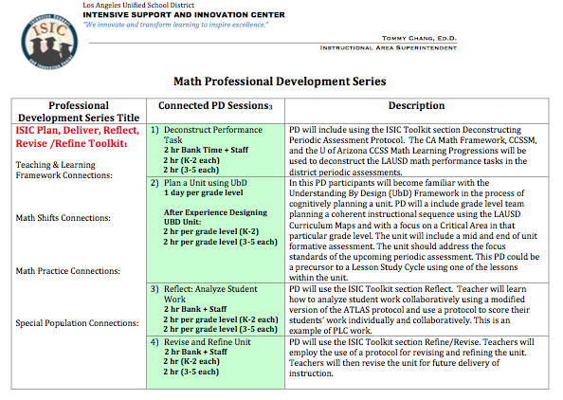
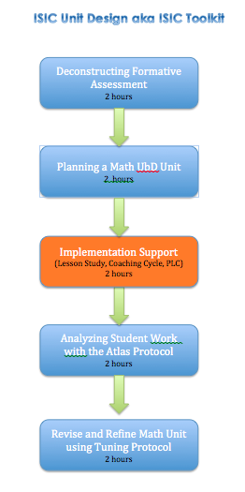
ISIC Teaching & Learning Cycle

Slide 16
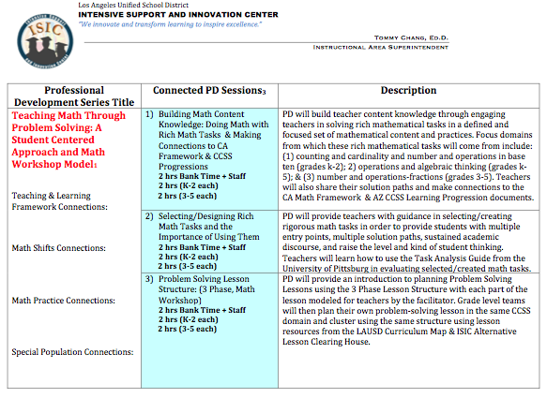
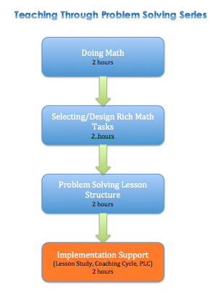
Teaching Math Through Problem Solving

Slide 17
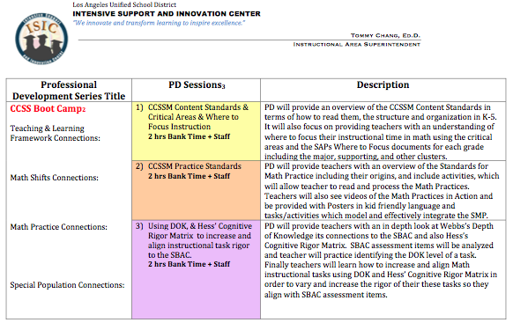
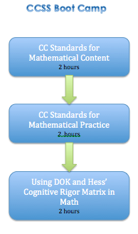
CCSS Boot Camp

Slide 18
20-The number, on average, of separate instances of practice it takes a teacher to master a new skill, and this number may increase if a skill is exceptionally complex. SOURCE: (Joyce & Showers, 2002).
If school districts want teachers to change instruction, the implementation stage must be included and supported more explicitly in professional development offerings, as this is the critical stage where teachers begin to commit to an instructional approach.

