Slide 1
Learning In, From, and For Teaching Practice: Number Strings 2nd Grade
Joseph Espinosa, NBCT
CCSS Math Facilitator
May 6th, 2015

Slide 2
SESSSession OutcomesION OBJECTIVES
Cognitively plan a number string
Rehearse that number string together
Debrief the learning of that number string

Slide 3
Inclusion
Share something about yourself that nobody knows about you.
Notes:
5 minutes
After everybody shares ask: Who played it safe and didn’t share their first thought? Why do people play it safe? How do expect to grow?
My share: held back in first grade because teacher felt I could not read well enough.

Slide 4
Grounding: Number Strings
Connecting Thoughts:
Line Up
One insight I got from article was . . .
Each person connect their thought to the previous person’s idea.
In summary:
A number string is a series of relate computation problems that are specifically designed to elicit quick, efficient, and reliable strategies for computation from students.

Slide 5
Number String Teaching Protocol
Read the Number String Teaching Protocol
Highlight important points you want to remember when teaching using number strings.

Slide 6
Number String Protocol Checklist
Purpose: Measures Fidelity to Number String Protocol
Notes:
1 minute

Slide 7
Let’s Plan a Number String

Slide 8
Addition String: B2
Read String B2:
Highlight key information related to:
Strategies
Big Ideas

Slide 9
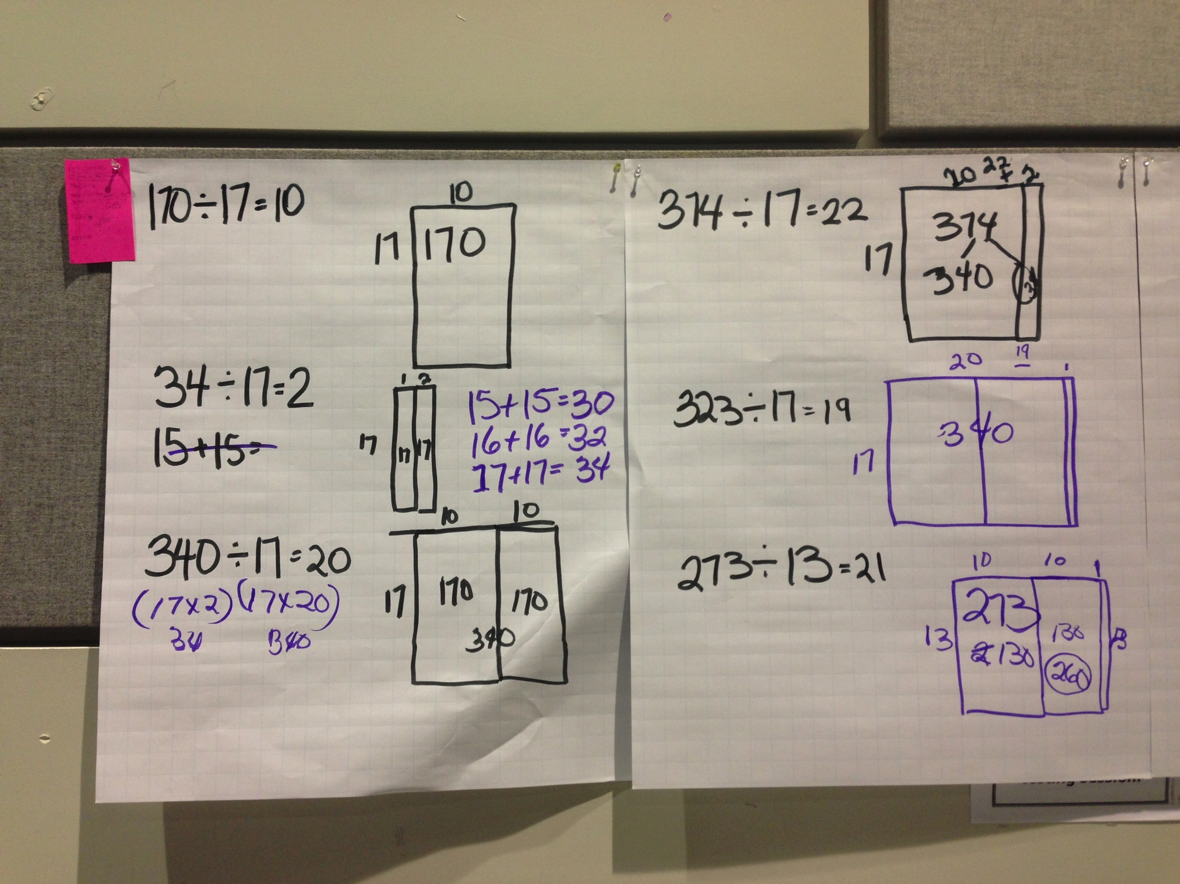
Planning a Number String
Number String: Addition String-B2
Initial Question
Target Goals (Math Goal(s) and SMP)
Anticipated Responses
Follow-Up Questions
Notes:
15 minutes
Everybody will have a part in the rehearsal.
Take a moment to read the

Slide 10
Math Practice Evidence Purpose: To measure engagement with SMPs
Notes:
1 minute

Slide 11
Math Observation Notes
Purpose: To measure what teacher does and says and students do and say
Notes:
1 minute

Slide 12
Data Collection Assignments
Data Type | Measurement | Assignment
Number String Protocol Components | Number String Protocol Checklist
Math Practices | Math Practice Evidence Bulleted SMP List
Teacher says and does, students say and do | Observation Script | Hang
Notes:
2 minutes
They will be provided several minutes to data after the demonstration

Slide 13
Let’s Rehearse the Number String

Slide 14
Rehearsal Batting Order
Introduction to Task and First Problem-Joseph
Second Problem-Reyna
Third Problem-Fabiola
Fourth Problem-Reyna
Fifth Problem-Fabiola
Sixth Problem and Closing of the Task-Joseph
Notes:
SAY: This rehearsal of the number string we just planned with be one where we tag in and tag out. So I will

Slide 15
Number String
3rd Problem
4th Problem
1st Problem
2nd Problem
5th Problem
Introduce the task to students
Pose the first problem
Pose the second problem
Pose the remaining problems
Highlight the big ideas and close the task.
Notes:
20 Minutes –Use a Timer
Say: We are going to begin this section with a number string. We all will be facilitating will be facilitating the demonstration. Remember, Number Strings are short, daily classroom conversations around purposefully crafted computation problems that are solved mentally. The Number Talk would then be followed by a problem solving lesson utilizing the Before, During, and After phases.

Slide 16
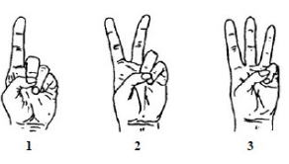
Hand signals
I’m thinking…
I have___ ways of solving the problem.
I’ve got an answer
I agree.
I disagree.
Notes:
Joseph
1 minute
(SAY)
We are now going to experience a string, which again, is a kind of Number Talk. Let’s go over some of the routines we are going to use during our string.
(Click and say) Hold fist against chest: This means I am thinking. I would like you to communicate with me throughout this number string. So unless you are using your fingers to compute, you should have your fist on your chest to show me that you’re thinking.
(Click and say) Hold fist against chest, extending fingers – Please use fingers to show me how many different ways you can solve a problem. Show me one finger, either your thumb or index finger, to let me know you have an answer. But I encourage you to not stop there but think of a different way to solve the problem and raise more fingers.
(Click and say) Make the “hang 10” or “shaka” sign: This means I agree. As teachers share their solutions and strategies, you need to listen carefully and communicate with me and that teacher whether you agree with what he or she is saying.
(Click and say) Do the “safe” sign in baseball – Similarly, you want to communicate that you disagree if you hear something you don’t agree with. This signal shows you disagree.

Slide 17
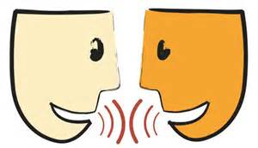
Sentence Frames
I agree with______ because _______.
I disagree with ______ because _______.
I do not understand _________. Can you explain this again?
How/Why did you decide to ________?
Notes:
Joseph
30 seconds
SAY)
Here are some sentence frames that could help you in responding to other participants as they share their solutions and strategies.
This is a poster that you can create to help your students, but more specifically your ELL student. It is a type of support for your language obejctives.

Slide 18
Number String-B2
43 + 20
43 + 24
43 + 44
52 + 30
52 + 39
68 + 22
68 + 29
Notes:
15 minutes

Slide 19
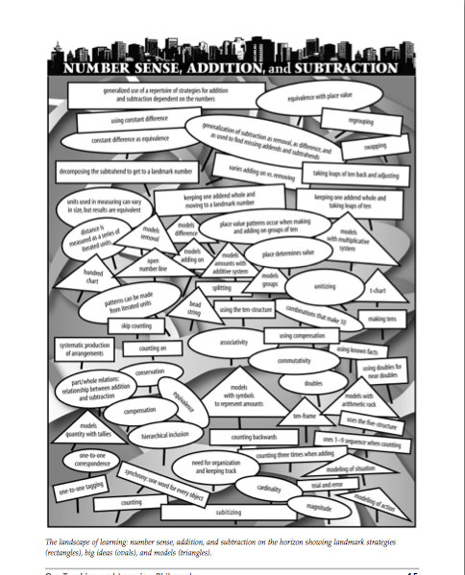
Behind the Making of this Number String
Addition String
Strategy(ies) Highlighted: Addition, One Number Whole and Taking Leaps of Ten
The first problem is the scaffold for the second. The third expression has a value of 20 greater than the second and again the same number line can be used.
The next two problems are paired with 39 being 9 more than 30.
The last two problems support students in exploring both strategies; using the tens first and then adding the units, and taking a larger leap and subtracting at the end.
Notes:
2 min.
[SAY]
Let’s debrief this addition string. The problems in the string were chosen to keep one number whole and take leaps of ten. What strategy from the primary grades do you think this string aimed to highlight? [Wait for responses. If someone addition,keeping one number whole and taking leaps of ten , validate. If not, SAY] The strategies were addition, keeping one number whole and taking leaps of ten.
The big idea t

Slide 20
Cathy Fosnot Minilessons
Extending Addition and Subtraction of Larger Numbers
Models:
Around the Circle
The Open Number Line with Connecting Cubes
The Open Number Line
The Money Model

Slide 21
Discussion Protocol
Instructors’ Reflections
Background Information from the Number String Study Members
Presentation and Discussion of Data from the Number String
General Discussion

Slide 22
Standards for Mathematical Practice
Overarching Habits of Mind
MP1 Make sense of problems and persevere in solving them.
MP6 Attend to precision.
Reasoning & Explaining
MP2 Reason abstractly and quantitatively.
MP3 Construct viable arguments and critique the reasoning of others.
Modeling &
Using Tools
MP4 Model with mathematics.
MP5 Use appropriate tools strategically.
Seeing Structure & Generalizing
MP7 Look for and make use of structure.
MP8 Look for and express regularity in repeated reasoning.
Notes:
SAY We also know that the eight MP standards can be grouped into the four categories as illustrated in the following chart and that we’ve spent the last 3 years focusing on MP1, 3, and 4. We want to shift on focus from those practices to MP 7 and MP8. Number Strings address these SMPs in particular.

Slide 23
SMP 7 and 8
Look for and make use of structure.
Look for and express regularity in repeated reasoning.
Notes:
SAY in your packet you have a copy of the SMPs. Take a minute to read them and then turn and talk with someone next to you about the practices. Explain to each other what students are doing and how they are thinking when engaging with MP7 and MP8.
PROVIDE 5 MINS.
SAY looking back at the string we just completed, what evidence of MP7 and MP8 do we see? Let’s do another pair share.
ELICIT RESPONSES.

Slide 24
Further Refining: Number String Rubric

Slide 25
Evaluation
http://bitly.com/isicfeedback
Contact
Joseph Espinosa
jae0598@lausd.net

