Slide 1
I do, We do, Error Analysis

Slide 2
Mr. C Does:
Find length of missing side
C
5
4
A
Steps:
Pythagorean Theorem
Substitute Numbers
Exponents
Solve for the variable
Square Root both sides
B
A² + B² = C²
4² + B² = 5²
16 + B² = 25
-16 -16
B² = 9
B = 3
Notes:
Label the sides first!

Slide 3
Students Do:
Find length of missing side
c = 13
a = ?
Steps:
Pythagorean Theorem
Substitute Numbers
Exponents
Solve for the variable
Square Root both sides
b = 12
A² + B² = C²
A² + 12² = 13²
A² + 144 = 169
-144 -144
A² = 25
A = 5

Slide 4
Error Analysis:
Find the mistake and explain it using vocabulary words if possible: Leg, hypotenuse, right angle.
c = ?
A² + B² = C²
6² + B² = 8²
36 + B² = 64
-36 -36
B² = 25
B= 5
a = 6
b = 8

Slide 5
Exit Slip with rubric

Slide 6
Exit Slip!
START
Time’s Up
2:30
– You have to work Alone.
– 1. Ask Teacher
– Work on
– Raise your hand to move out of your seat.
– Work quietly, fast, and stay on task.
Exit Slip
Don’t waste your time!
5:00

Slide 7
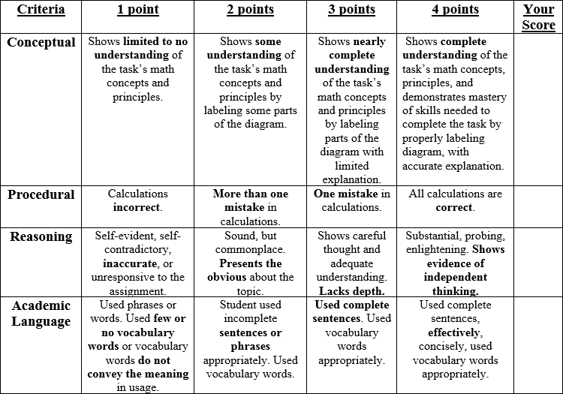

Slide 8
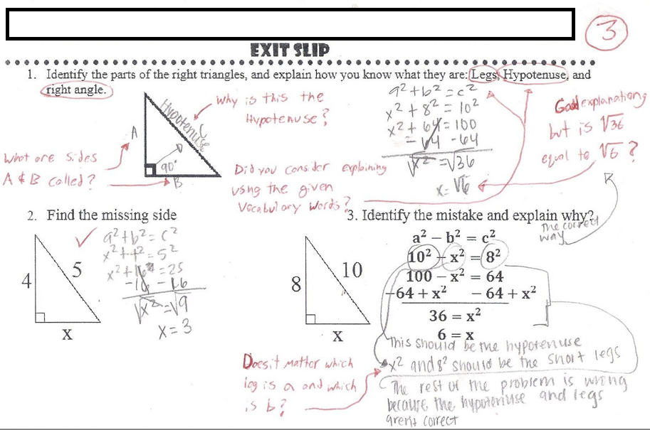
Student work Sample

Slide 9
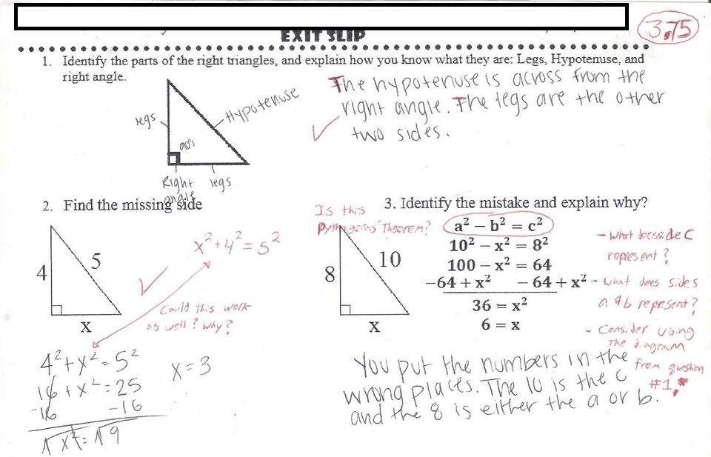
Student work Sample

Slide 10
Analyze and apply!

Slide 11
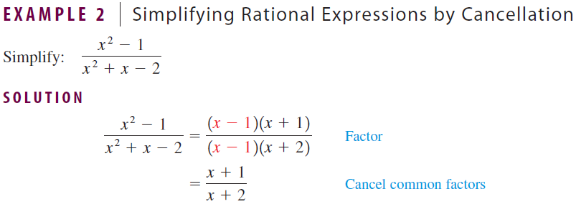
Analyze book Example
Answer questions in Notebook:
What techniques did the book used to simplify the polynomial?
What type of factoring was used in this example?
How did factoring help simplify this rational expression?

Slide 12
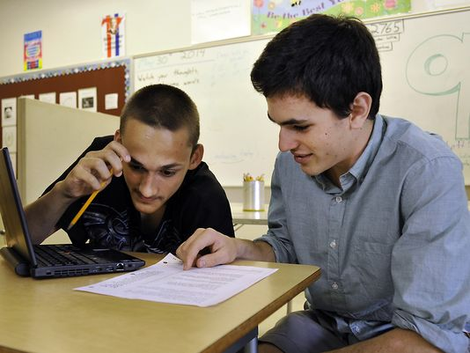
Analyze book Example
Pair up and pick a partner A and B.
Partner A share #1.
Partner B respond and share #2.
Partner A respond and share #3.

Slide 13
Apply book Example
(With your partner)
Apply what you learned from example 2:
Simplify.
x² + 5x + 6
x + 2
1.
2.
x+3
2x² + 8x + 8
x² + 5x + 6
2(x + 2)
(x+3)

Slide 14
So to SIMPLIFY rational expressions, factor to see what you can cancel
We do!
2.) 8x + 72 .
10x² + 100x + 90
= 8(x + 9)
10(x² + 10x + 9)
= 8(x + 9)
10(x + 9)(x + 1)
= 4 .
5(x + 1)
1.) x + 4 .
2x² - 2x – 40
= (x + 4) .
2(x + 4)(x – 5)
= 1
2(x - 5)
Reduce!
When you
cancel it
becomes a 1

Slide 15
SIMPLIFY the rational expressions
Students do!
2.) 3x² + 9x + 6 .
6x² + 36x + 30
= 3(x² + 3x + 2)
6(x² + 6x + 5)
= 3(x + 1)(x + 2)
6(x + 5)(x + 1)
= (x + 2) .
2(x + 5)
1.) x – 2 .
x² + x – 6
= (x – 2) .
(x + 3) (x – 2)
= 1
x+3
Remember
when you cancel
it becomes a
1
Reduce!
NOW you are ready!

Slide 16
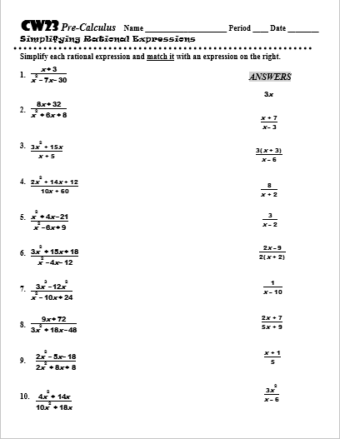
Practice time

Slide 17
– You can work independently or with the person next to you.
– 1. Check Notes 2. Ask Neighbor
3. Ask Teacher
– Work on
– Raise your hand to move out of your seat.
– Work quietly, fast, and stay on task.
Cw23 #1-10

Slide 18
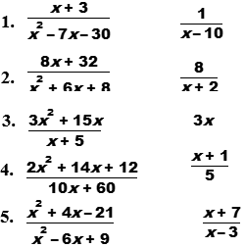
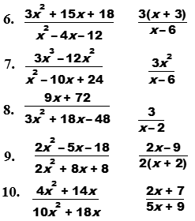
Answers

